Slide 1

Lemma Synthesis via Conjecture, Learn, Compress
By Brando Miranda

Slide 2
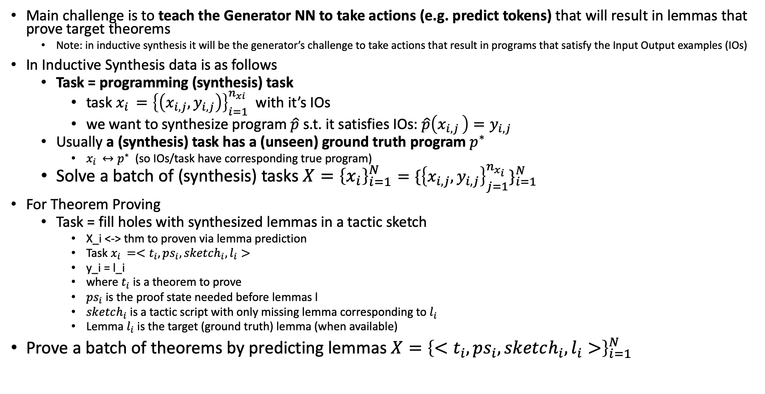
The Formal Language Synthesis Problem
Main challenge is to teach the Generator NN to take actions (e.g. predict tokens) that will result in lemmas that prove target theorems
Note: in inductive synthesis it will be the generator’s challenge to take actions that result in programs that satisfy the Input Output examples (IOs)
In Inductive Synthesis data is as follows
Task = programming (synthesis) task
task $x_{i }={\left\{\left(x_{i,j}, y_{i,j}\right)\right\}}_{i=1}^{n_{xi}}$ with it’s IOs
we want to synthesize program $\hat{p}$ s.t. it satisfies IOs: $\hat{p}\left(x_{i,j }\right)=y_{i,j}$
Usually a (synthesis) task has a (unseen) ground truth program $p^{∗}$
$x_{i }↔p^{∗}$ (so IOs/task have corresponding true program)
Solve a batch of (synthesis) tasks $X={\left\{x_{i}\right\}}_{i=1}^{N}={\{{\left\{x_{i,j}, y_{i,j}\right\}}_{j=1}^{n_{x_{i}}}\}}_{i=1}^{N}$
For Theorem Proving
Task = fill holes with synthesized lemmas in a tactic sketch
X_i <-> thm to proven via lemma prediction
Task $x_{i }={<t}_{i}, ps_{i}, sketch_{i}, l_{i}>$
y_i = l_i
where $t_{i}$ is a theorem to prove
$ps_{i}$ is the proof state needed before lemmas l
$sketch_{i}$ is a tactic script with only missing lemma corresponding to $l_{i}$
Lemma $l_{i}$is the target (ground truth) lemma (when available)
Prove a batch of theorems by predicting lemmas $X={\left\{{<t}_{i}, ps_{i}, sketch_{i}, l_{i}>\right\}}_{i=1}^{N}$
Notes:
How to choose lemmas? Whenever tactic script uses a lemma e.g. uses the apply tactic
TALIA: more ideas to which tactics to use to generate data set we need

Slide 3
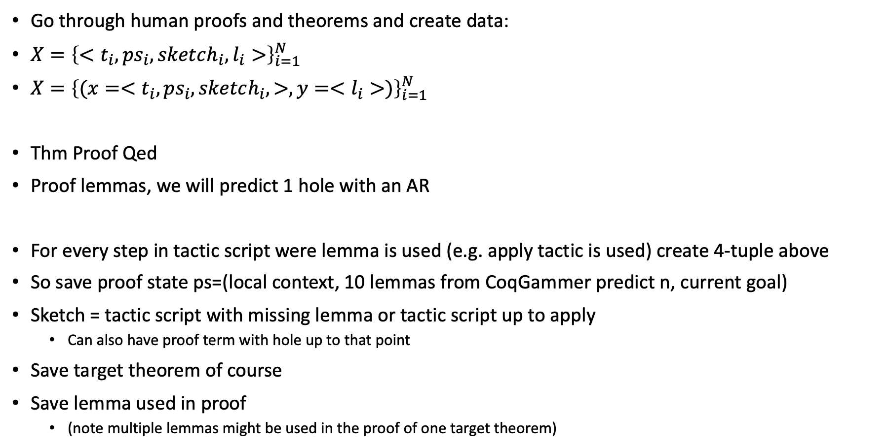
Generating Data Set
Go through human proofs and theorems and create data:
$X={\left\{{<t}_{i}, ps_{i}, sketch_{i}, l_{i}>\right\}}_{i=1}^{N}$
$X={\left\{{(x=<t}_{i}, ps_{i}, sketch_{i}, >,y=<l_{i}>)\right\}}_{i=1}^{N}$
Thm Proof Qed
Proof lemmas, we will predict 1 hole with an AR
For every step in tactic script were lemma is used (e.g. apply tactic is used) create 4-tuple above
So save proof state ps=(local context, 10 lemmas from CoqGammer predict n, current goal)
Sketch = tactic script with missing lemma or tactic script up to apply
Can also have proof term with hole up to that point
Save target theorem of course
Save lemma used in proof
(note multiple lemmas might be used in the proof of one target theorem)
Notes:
- Fine tune from github, eric, task2vec

Slide 4
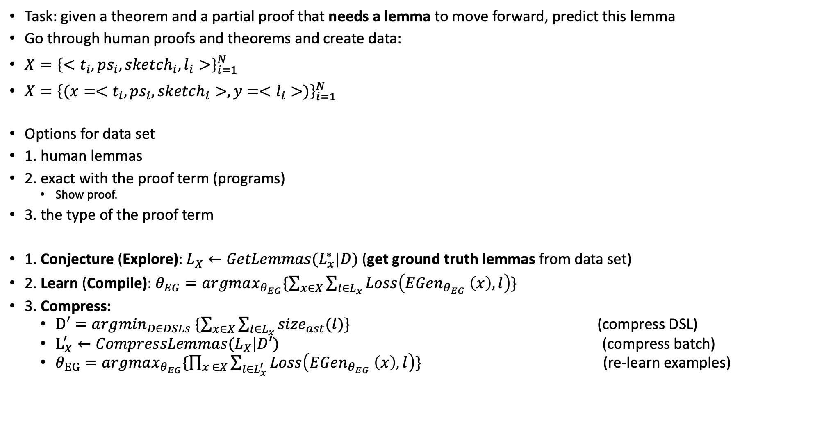
Generating Data Set
Task: given a theorem and a partial proof that needs a lemma to move forward, predict this lemma
Go through human proofs and theorems and create data:
$X={\left\{{<t}_{i}, ps_{i}, sketch_{i}, l_{i}>\right\}}_{i=1}^{N}$
$X={\left\{{(x=<t}_{i}, ps_{i}, sketch_{i}>,y=<l_{i}>)\right\}}_{i=1}^{N}$
Options for data set
1. human lemmas
2. exact with the proof term (programs)
Show proof.
3. the type of the proof term
1. Conjecture (Explore): $L_{X}←{GetLemmas(L}_{x}^{∗}|D)$ (get ground truth lemmas from data set)
2. Learn (Compile): $θ_{EG}=argmax_{θ_{EG}}\{\sum_{x∈X}{\sum_{l∈L_{x}}{Loss\left(EGen_{θ_{EG}} \left(x\right), l\right)}}\}$
3. Compress:
$D′=argmin_{D∈DSLs} \{\sum_{x∈X}{\sum_{l∈L_{x}}{size_{ast}(l)}}\}$ (compress DSL)
$L_{X}^{′}←CompressLemmas(L_{X}|D′)$ (compress batch)
$θ_{EG}=argmax_{θ_{EG}}\{\prod_{x ∈X}{\sum_{l∈L_{x}^{′}}{Loss\left(EGen_{θ_{EG}} \left(x\right), l\right)\}}}$ (re-learn examples)
Notes:
- Fine tune from github, eric, task2vec

Slide 5
Terminology
Synthesizer Actions = which program token/construct to select
Examples:
which grammar rule to predict e.g. <term> -> “fun” <term> “:” <type> “.” <term>
which token to predict e.g. “a”, “b”, “map”, “+”, “-”, etc.
Which language construct to predict e.g. AST like “let in”, “Abs”, “Apply”
Generator NN (or just Generator or GenNN or EGen) = Neural Network model that predicts actions
Examples:
Neural Recognition model + Enu (in EC^2, DC, …)
Transformer model (in TreeGen, Codex, PloyCode, AlphaCode, …)
Synthesis Search (or if obvious from context just search):
Examples:
Enumeration (bottom up or top down or mix)
Beam Search (for transformers)
Greedy (usually for transformers)
Filter (e.g. Beam Search + Filter via matching IOs or Passes Coq’s check)
Synthesizer = Generator NN + Synthesize Search
Valid program/lemma = a program that satisfies IOs or a lemma that proves target theorem or closes current subgoal. Note ground truth lemmas are valid lemmas.
DSL optimizer Action = what action to take to improve (Difficult!)
DC, EC^2

Slide 6

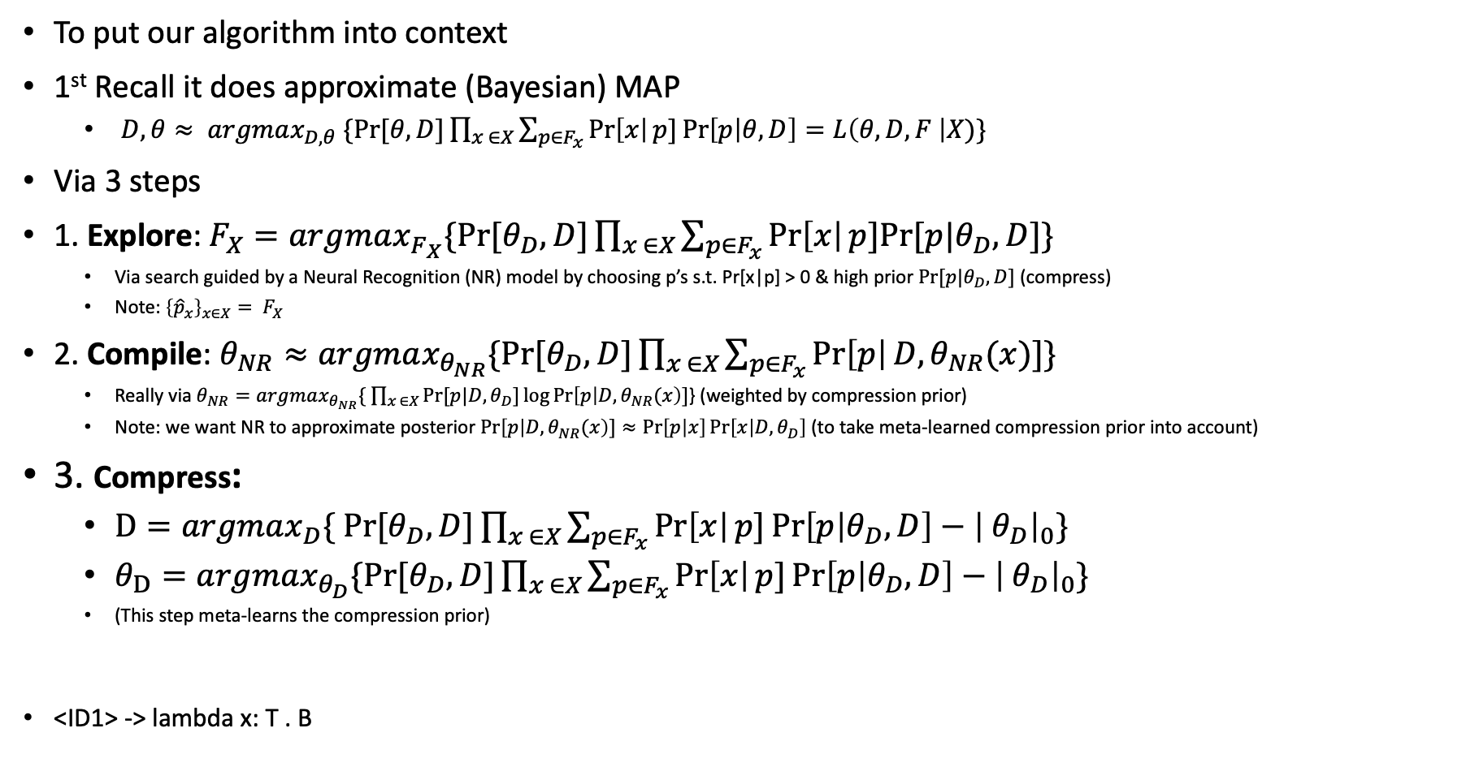
Recall $EC^{2}$
To put our algorithm into context
1st Recall it does approximate (Bayesian) MAP
$D, θ≈ argmax_{D, θ} \{Pr⁡[θ,D]\prod_{x ∈X}{\sum_{p∈F_{x}}{\operatorname{Pr}\left[x\right|p]\operatorname{Pr}\left[p | θ, D\right]=L\left(θ, D, F \right|X)\}}}$
Via 3 steps
1. Explore: $F_{X}=argmax_{F_{X}}\{Pr⁡[θ_{D},D]\prod_{x ∈X}{\sum_{p∈F_{x}}{\operatorname{Pr}\left[x\right|p]Pr⁡[p|θ_{D}, D]\}}}$
Via search guided by a Neural Recognition (NR) model by choosing p’s s.t. Pr[x|p] > 0 & high prior $Pr⁡[p|θ_{D}, D]$ (compress)
Note: ${{\left\{{\hat{p}}_{x}\right\}}_{x∈X}= F}_{X}$
2. Compile: $θ_{NR}≈argmax_{θ_{NR}}\{Pr⁡[θ_{D},D]\prod_{x ∈X}{\sum_{p∈F_{x}}{\operatorname{Pr}\left[p\right|D, θ_{NR}(x)]\}}}$
Really via $θ_{NR}=argmax_{θ_{NR}}\{ \prod_{x ∈X}{Pr⁡[p|D, θ_{D}]\log{\operatorname{Pr}\left[p | D, θ_{NR}(x\right)]}}$} (weighted by compression prior)
Note: we want NR to approximate posterior $\operatorname{Pr}\left[p | D, θ_{NR}(x\right)]≈\operatorname{Pr}\left[p | x\right]\operatorname{Pr}\left[x | D, θ_{D}\right]$ (to take meta-learned compression prior into account)
3. Compress:
$D=argmax_{D}\{ Pr⁡[θ_{D},D]\prod_{x ∈X}{\sum_{p∈F_{x}}{\operatorname{Pr}\left[x\right|p]\operatorname{Pr}\left[p | θ_{D}, D\right]−{\left| θ_{D}\right|}_{0}\}}}$
$θ_{D}=argmax_{θ_{D}}\{Pr⁡[θ_{D},D]\prod_{x ∈X}{\sum_{p∈F_{x}}{\operatorname{Pr}\left[x\right|p]\operatorname{Pr}\left[p | θ_{D}, D\right]−{\left| θ_{D}\right|}_{0}\}}}$
(This step meta-learns the compression prior)
<ID1> -> lambda x: T . B
Notes:
Note: DSL can also generate lemmas and theorem to be proved

Slide 7

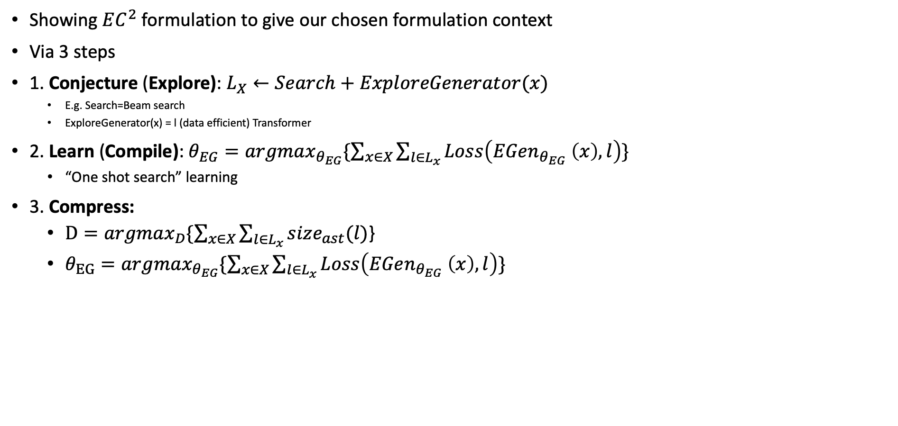
Our Possible Formulation ala $EC^{2}$
Showing $EC^{2}$ formulation to give our chosen formulation context
Via 3 steps
1. Conjecture (Explore): $L_{X}←Search+ExploreGenerator(x)$
E.g. Search=Beam search
ExploreGenerator(x) = l (data efficient) Transformer
2. Learn (Compile): $θ_{EG}=argmax_{θ_{EG}}\{\sum_{x∈X}{\sum_{l∈L_{x}}{Loss\left(EGen_{θ_{EG}} \left(x\right), l\right)}}\}$
“One shot search” learning
3. Compress:
$D=argmax_{D}\{\sum_{x∈X}{\sum_{l∈L_{x}}{size_{ast}(l)}}$}
$θ_{EG}=argmax_{θ_{EG}}\{\sum_{x∈X}{\sum_{l∈L_{x}}{Loss\left(EGen_{θ_{EG}} \left(x\right), l\right)}}\}$
Notes:
Note: DSL can also generate lemmas and theorem to be proved

Slide 8
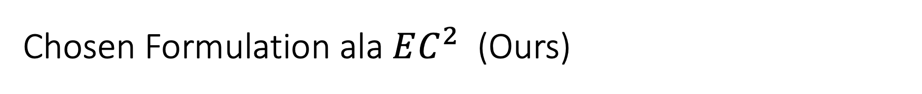
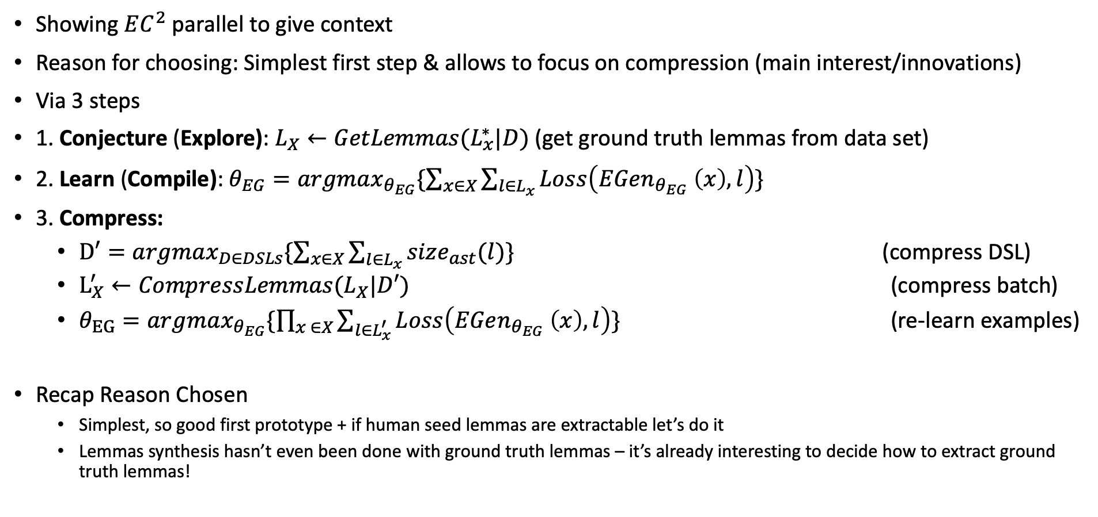
Chosen Formulation ala $EC^{2}$ (Ours)
Showing $EC^{2}$ parallel to give context
Reason for choosing: Simplest first step & allows to focus on compression (main interest/innovations)
Via 3 steps
1. Conjecture (Explore): $L_{X}←{GetLemmas(L}_{x}^{∗}|D)$ (get ground truth lemmas from data set)
2. Learn (Compile): $θ_{EG}=argmax_{θ_{EG}}\{\sum_{x∈X}{\sum_{l∈L_{x}}{Loss\left(EGen_{θ_{EG}} \left(x\right), l\right)}}\}$
3. Compress:
$D′=argmax_{D∈DSLs}\{\sum_{x∈X}{\sum_{l∈L_{x}}{size_{ast}(l)}}\}$ (compress DSL)
$L_{X}^{′}←CompressLemmas(L_{X}|D′)$ (compress batch)
$θ_{EG}=argmax_{θ_{EG}}\{\prod_{x ∈X}{\sum_{l∈L_{x}^{′}}{Loss\left(EGen_{θ_{EG}} \left(x\right), l\right)\}}}$ (re-learn examples)
Recap Reason Chosen
Simplest, so good first prototype + if human seed lemmas are extractable let’s do it
Lemmas synthesis hasn’t even been done with ground truth lemmas – it’s already interesting to decide how to extract ground truth lemmas!
Notes:
Note: no explore after Learn/Compile like EC^2 since we never used beam search/enumeration/search to get lemmas (lemmas/programs that satisfy IOs/task) in the first place
Possible to extend ground truth lemmas with e-graphs for data augmentation

Slide 9
Novelty Innovations – using Simple Compile Compress/Learn Compress
Using C^2/LC
Explore/Conjecture -> is by passed by sampling ground truth theorems from data set e.g. CoqGym
Innovation
1. Application of Synthesis of Programs (lemmas) to a full fledge (complicated) language like Coq
Contrast DC/EC^2 to simple lambda calc – which is (to my understanding), only the back bone of LISP
2. New application to Synthesis of Lemmas – very important task for TP itself
FM community value it!
IIT/HOL not only FOL
3. *** Algorithmically, improving compression algorithm ***
Expand beyond PCFG
Using deep learning
Combinatorial NN opt? or other techniques!
E-graphs to choose sub-expressions to add to DSL (compare with unification in EC^2)
Others I’ve not thought of yet?!
4. First time neutralizing original EC^2/adding significant Deep Learning components
Ideally we can make fundamental improvements to compress – beyond say, only neutralizing the probability distribution that PCFG/FG have
5. Meta-learning through tasks of different proving environments instead of programming tasks
E.g. synthesize lemmas that generalize in simple algebra, real analysis, program verification, Homotopy Type Theory (HoTT)
(less,

Slide 10
Compress!

Slide 11
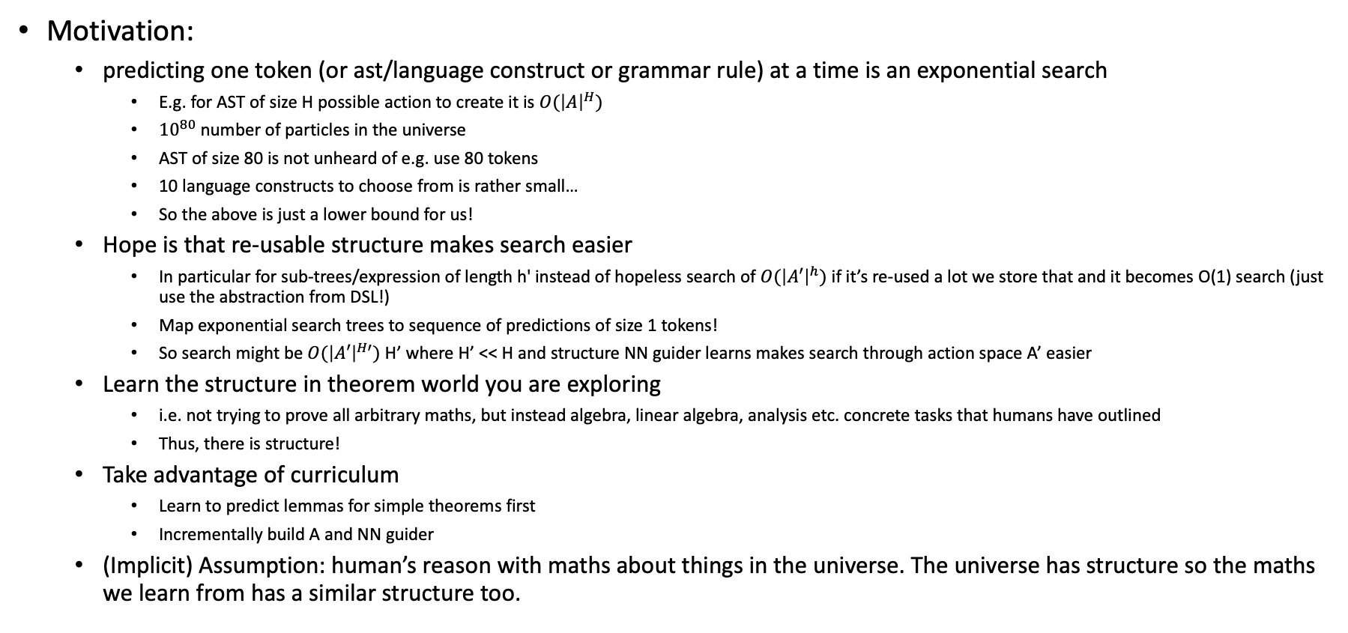
Motivation: Compress – Learning compositional DSL
Motivation:
predicting one token (or ast/language construct or grammar rule) at a time is an exponential search
E.g. for AST of size H possible action to create it is ${O(\left|A\right|}^{H})$
${10}^{80}$ number of particles in the universe
AST of size 80 is not unheard of e.g. use 80 tokens
10 language constructs to choose from is rather small…
So the above is just a lower bound for us!
Hope is that re-usable structure makes search easier
In particular for sub-trees/expression of length h' instead of hopeless search of ${O(\left|A′\right|}^{h})$ if it’s re-used a lot we store that and it becomes O(1) search (just use the abstraction from DSL!)
Map exponential search trees to sequence of predictions of size 1 tokens!
So search might be ${O(\left|A′\right|}^{H′})$ H’ where H’ << H and structure NN guider learns makes search through action space A’ easier
Learn the structure in theorem world you are exploring
i.e. not trying to prove all arbitrary maths, but instead algebra, linear algebra, analysis etc. concrete tasks that humans have outlined
Thus, there is structure!
Take advantage of curriculum
Learn to predict lemmas for simple theorems first
Incrementally build A and NN guider
(Implicit) Assumption: human’s reason with maths about things in the universe. The universe has structure so the maths we learn from has a similar structure too.
Notes:
Q: is training a DSL the if it’s not the bottle neck? Perhaps the best is to generate the largest data set possible and train a transformer?

Slide 12
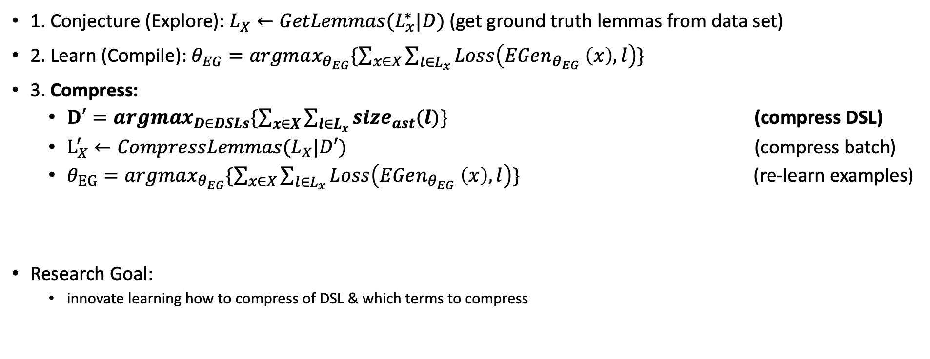
Recall our formulation
1. Conjecture (Explore): $L_{X}←{GetLemmas(L}_{x}^{∗}|D)$ (get ground truth lemmas from data set)
2. Learn (Compile): $θ_{EG}=argmax_{θ_{EG}}\{\sum_{x∈X}{\sum_{l∈L_{x}}{Loss\left(EGen_{θ_{EG}} \left(x\right), l\right)}}\}$
3. Compress:
$D′=argmax_{D∈DSLs}\{\sum_{x∈X}{\sum_{l∈L_{x}}{size_{ast}(l)}}\}$ (compress DSL)
$L_{X}^{′}←CompressLemmas(L_{X}|D′)$ (compress batch)
$θ_{EG}=argmax_{θ_{EG}}\{\sum_{x∈X}{\sum_{l∈L_{x}}{Loss\left(EGen_{θ_{EG}} \left(x\right), l\right)}}\}$ (re-learn examples)
Research Goal:
innovate learning how to compress of DSL & which terms to compress

Slide 13
What problem should the compression algorithm that learns the DSL solve?
Compress Goal: learn to compress DSL that aids synthesis search (that solves tasks)
Synthesis that completes proofs
Hypothesis how this is achieved:
Compresses programs/lemmas that work on tasks/thms
=> means; shorter sequence prediction or search
=> implies also; reusability & compositionality makes sequence prediction or synthesis search easier

Slide 14
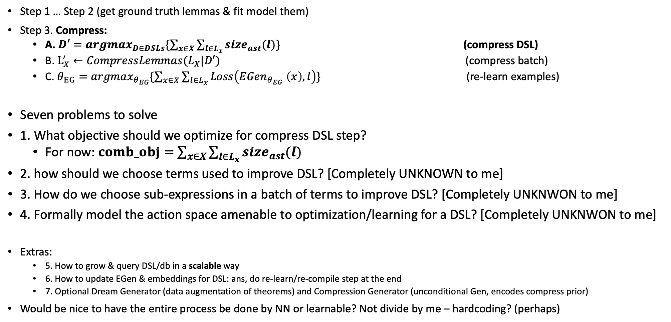
What problems do we need to solve from our formulation?
Step 1 … Step 2 (get ground truth lemmas & fit model them)
Step 3. Compress:
A. $D′=argmax_{D∈DSLs}\{\sum_{x∈X}{\sum_{l∈L_{x}}{size_{ast}(l)}}\}$ (compress DSL)
B. $L_{X}^{′}←CompressLemmas(L_{X}|D′)$ (compress batch)
C. $θ_{EG}=argmax_{θ_{EG}}\{\sum_{x∈X}{\sum_{l∈L_{x}}{Loss\left(EGen_{θ_{EG}} \left(x\right), l\right)}}\}$ (re-learn examples)
Seven problems to solve
1. What objective should we optimize for compress DSL step?
For now: $comb_obj=$ $\sum_{x∈X}{\sum_{l∈L_{x}}{size_{ast}(l)}}$
2. how should we choose terms used to improve DSL? [Completely UNKNOWN to me]
3. How do we choose sub-expressions in a batch of terms to improve DSL? [Completely UNKNWON to me]
4. Formally model the action space amenable to optimization/learning for a DSL? [Completely UNKNWON to me]
Extras:
5. How to grow & query DSL/db in a scalable way
6. How to update EGen & embeddings for DSL: ans, do re-learn/re-compile step at the end
7. Optional Dream Generator (data augmentation of theorems) and Compression Generator (unconditional Gen, encodes compress prior)
Would be nice to have the entire process be done by NN or learnable? Not divide by me – hardcoding? (perhaps)
Notes:
Intuitively, we want to select a DSL as to maximize number of theorems proved when the Synthesizer (GenNN+Synth Search)

Slide 15
My current & 1st Idea for doing compression
Want to show current idea and 1st idea
Evaluate it with Pros and cons
Get feedback on how to proceed
My suggestion: a combination of lit review & hard deep thinking
Possible to slowly one step at a time “peal off” the hardcoding and replace with learnable components
Pros
+ It is concrete and articulates the problems we want to solve well with some (not super dumb) solution
(even if current solution is sort of hardcoded not as fully learnable as I want to make it)
+ Makes clear problem formulation which eases comparison with previous work/lit review
(e.g. I don’t think it is that much worse than what DC does, idk about EC^2’s FG)
Cons
- hard coded or not as end-to-end learnable
E.g. very combinatorically symbolically formulated (for now)
Want to make it more learnable, but to many options…?
Neural Combinatorial, RL, EC^2’s FG, DC, Evolutionary, Genetics, NAS, Bayesian Opt, GFlowNets, learning action spaces others?
- need to do a better literature review, especially comparison with EC^2’s Fragment Grammars (FG), DreamCoder

Slide 16
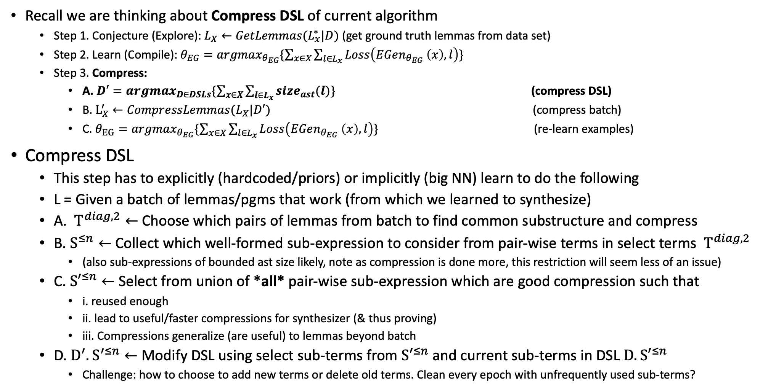
My current & 1st Idea for doing compression
Recall we are thinking about Compress DSL of current algorithm
Step 1. Conjecture (Explore): $L_{X}←{GetLemmas(L}_{x}^{∗}|D)$ (get ground truth lemmas from data set)
Step 2. Learn (Compile): $θ_{EG}=argmax_{θ_{EG}}\{\sum_{x∈X}{\sum_{l∈L_{x}}{Loss\left(EGen_{θ_{EG}} \left(x\right), l\right)}}\}$
Step 3. Compress:
A. $D′=argmax_{D∈DSLs}\{\sum_{x∈X}{\sum_{l∈L_{x}}{size_{ast}(l)}}\}$ (compress DSL)
B. $L_{X}^{′}←CompressLemmas(L_{X}|D′)$ (compress batch)
C. $θ_{EG}=argmax_{θ_{EG}}\{\sum_{x∈X}{\sum_{l∈L_{x}}{Loss\left(EGen_{θ_{EG}} \left(x\right), l\right)}}\}$ (re-learn examples)
Compress DSL
This step has to explicitly (hardcoded/priors) or implicitly (big NN) learn to do the following
L = Given a batch of lemmas/pgms that work (from which we learned to synthesize)
A. $T^{diag,2}←$ Choose which pairs of lemmas from batch to find common substructure and compress
B. $S^{≤n}←$Collect which well-formed sub-expression to consider from pair-wise terms in select terms $T^{diag,2}$
(also sub-expressions of bounded ast size likely, note as compression is done more, this restriction will seem less of an issue)
C. ${S′}^{≤n}←$ Select from union of *all* pair-wise sub-expression which are good compression such that
i. reused enough
ii. lead to useful/faster compressions for synthesizer (& thus proving)
iii. Compressions generalize (are useful) to lemmas beyond batch
D. $D^{′}.S^{′≤n}←$ Modify DSL using select sub-terms from ${S′}^{≤n}$ and current sub-terms in DSL ${D.S′}^{≤n}$
Challenge: how to choose to add new terms or delete old terms. Clean every epoch with unfrequently used sub-terms?
Notes:
Note: ideally since it’s a curriculum from a human seed (which are naturally already ordered) – the number of subexpressions won’t explore
Random idea: would be cool to apply to proof level compression and try to synthesize the proof term directly
note as compression is done more, this restriction will seem less of an issue, since yes at the beginning it might seem there are MANY sub-expressions & we are forgoing a lot. However, after our first compression, the <=n is no longer considering individual very fine-grained constructs, it’s going to start doing compression with more high-level terms/abstraction. So compression compounds more and more! Especially if there IS a lot of re-usability.

Slide 17
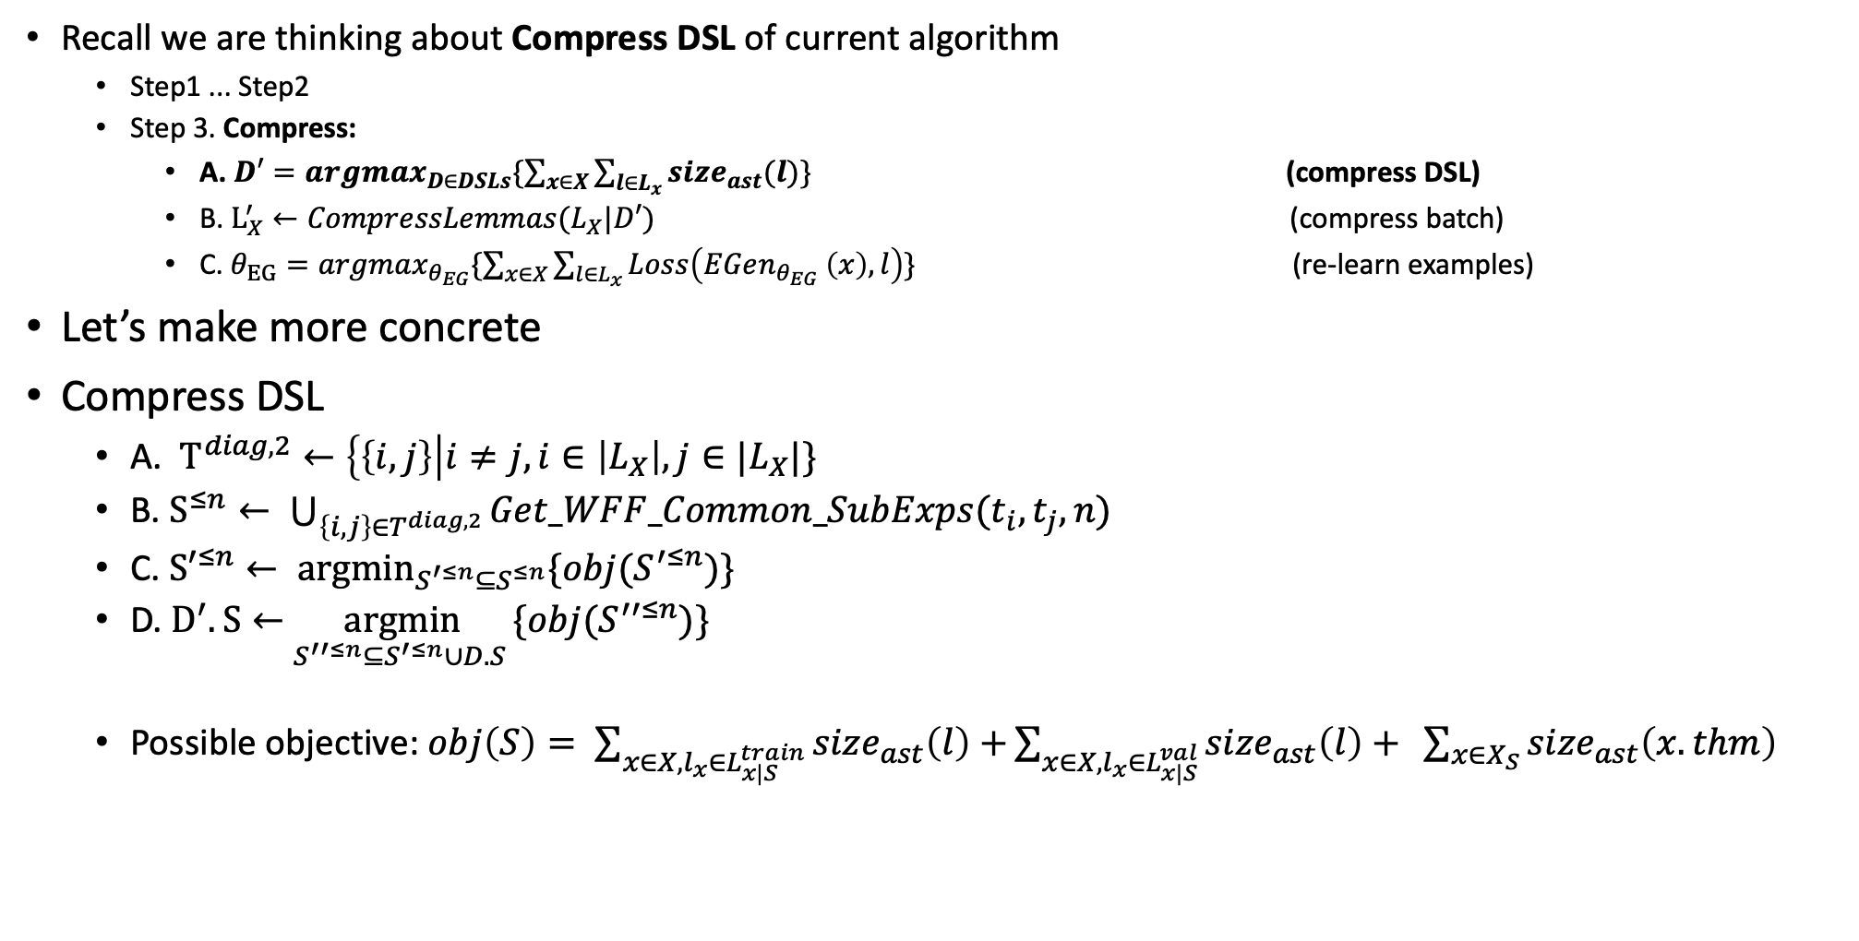
My current & 1st Idea for doing compression
Recall we are thinking about Compress DSL of current algorithm
Step1 ... Step2
Step 3. Compress:
A. $D′=argmax_{D∈DSLs}\{\sum_{x∈X}{\sum_{l∈L_{x}}{size_{ast}(l)}}\}$ (compress DSL)
B. $L_{X}^{′}←CompressLemmas(L_{X}|D′)$ (compress batch)
C. $θ_{EG}=argmax_{θ_{EG}}\{\sum_{x∈X}{\sum_{l∈L_{x}}{Loss\left(EGen_{θ_{EG}} \left(x\right), l\right)}}\}$ (re-learn examples)
Let’s make more concrete
Compress DSL
A. $T^{diag,2}←\left\{\left\{i, j\right\}\right|i≠j, i∈\left|L_{X}\right|, j∈|L_{X}|\}$
B. $S^{≤n}← \bigcup_{\left\{i, j\right\}∈T^{diag, 2}}{Get_WFF_Common_SubExps(t_{i}, t_{j}, n)}$
C. ${S′}^{≤n}← \underset{S^{′≤n}⊆S^{≤n}}{argmin}{\{obj(S^{′≤n})\}}$
D. $D^{′}.S←$ $\underset{S^{′′≤n}⊆S^{′≤n}∪D.S }{argmin}{\{obj(S^{′′≤n})\}}$
Possible objective: $obj\left(S\right)= \sum_{x∈X,l_{x}∈L_{x|S}^{train}}{size_{ast}\left(l\right)+}\sum_{x∈X, l_{x}∈L_{x|S}^{val}}{size_{ast}\left(l\right)+ }\sum_{x∈X_{S}}{size_{ast}\left(x.thm\right) }$
Notes:
All lemmas in batch
All WFF sub-expression of at most some size <= n
Choose subset from WFF sub-expression of size <= n, which would lead to the best compression (in terms of reusability, synthesizer speed, generalization outside of batch)
Choose subset that generalize from both bounded WFF sub-exps from batch and bounded current learned sub-exps in DSL
Q: what if l’s in batch are already compressed…? How do we choose how to rewrite terms?
BPE
Currying

Slide 18
TODO: slides to make each step even MORE concrete

Slide 19
Other Formulations of Conjecture Learn Compress (CLC)

Slide 20
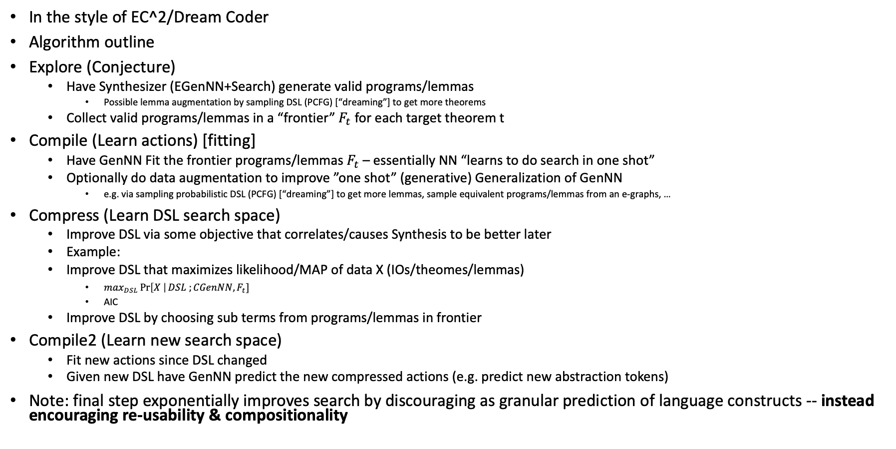
One possible algorithm Formulation
In the style of EC^2/Dream Coder
Algorithm outline
Explore (Conjecture)
Have Synthesizer (EGenNN+Search) generate valid programs/lemmas
Possible lemma augmentation by sampling DSL (PCFG) [“dreaming”] to get more theorems
Collect valid programs/lemmas in a “frontier” $F_{t}$ for each target theorem t
Compile (Learn actions) [fitting]
Have GenNN Fit the frontier programs/lemmas $F_{t}$ – essentially NN “learns to do search in one shot”
Optionally do data augmentation to improve ”one shot” (generative) Generalization of GenNN
e.g. via sampling probabilistic DSL (PCFG) [“dreaming”] to get more lemmas, sample equivalent programs/lemmas from an e-graphs, …
Compress (Learn DSL search space)
Improve DSL via some objective that correlates/causes Synthesis to be better later
Example:
Improve DSL that maximizes likelihood/MAP of data X (IOs/theomes/lemmas)
$\max_{DSL}\operatorname{Pr}\left[X \right|DSL ;CGenNN, F_{t}]$
AIC
Improve DSL by choosing sub terms from programs/lemmas in frontier
Compile2 (Learn new search space)
Fit new actions since DSL changed
Given new DSL have GenNN predict the new compressed actions (e.g. predict new abstraction tokens)
Note: final step exponentially improves search by discouraging as granular prediction of language constructs -- instead encouraging re-usability & compositionality
Notes:
Note: DSL can also generate lemmas and theorem to be proved

Slide 21
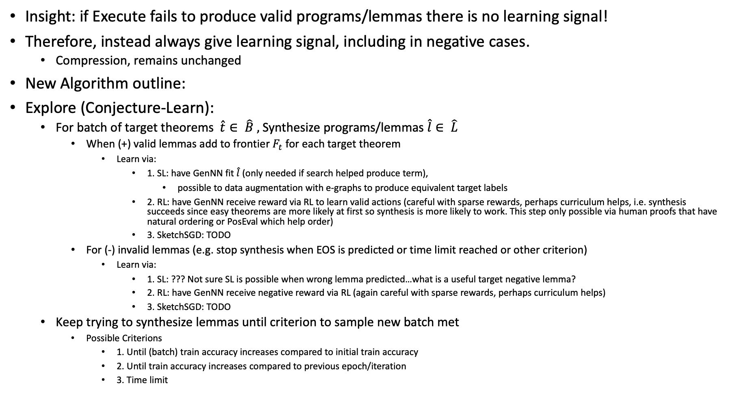
Another Possible algorithm Formulation
Insight: if Execute fails to produce valid programs/lemmas there is no learning signal!
Therefore, instead always give learning signal, including in negative cases.
Compression, remains unchanged
New Algorithm outline:
Explore (Conjecture-Learn):
For batch of target theorems $\hat{t}∈ \hat{B} ,$Synthesize programs/lemmas $\hat{l}∈ \hat{L}$
When (+) valid lemmas add to frontier $F_{t}$ for each target theorem
Learn via:
1. SL: have GenNN fit $\hat{l}$ (only needed if search helped produce term),
possible to data augmentation with e-graphs to produce equivalent target labels
2. RL: have GenNN receive reward via RL to learn valid actions (careful with sparse rewards, perhaps curriculum helps, i.e. synthesis succeeds since easy theorems are more likely at first so synthesis is more likely to work. This step only possible via human proofs that have natural ordering or PosEval which help order)
3. SketchSGD: TODO
For (-) invalid lemmas (e.g. stop synthesis when EOS is predicted or time limit reached or other criterion)
Learn via:
1. SL: ??? Not sure SL is possible when wrong lemma predicted…what is a useful target negative lemma?
2. RL: have GenNN receive negative reward via RL (again careful with sparse rewards, perhaps curriculum helps)
3. SketchSGD: TODO
Keep trying to synthesize lemmas until criterion to sample new batch met
Possible Criterions
1. Until (batch) train accuracy increases compared to initial train accuracy
2. Until train accuracy increases compared to previous epoch/iteration
3. Time limit
Notes:
Note: e-graphs can also be used during synthesis to generate equivalent lemmas from predicted and see which one will work
Sparse rewards issue

Slide 22
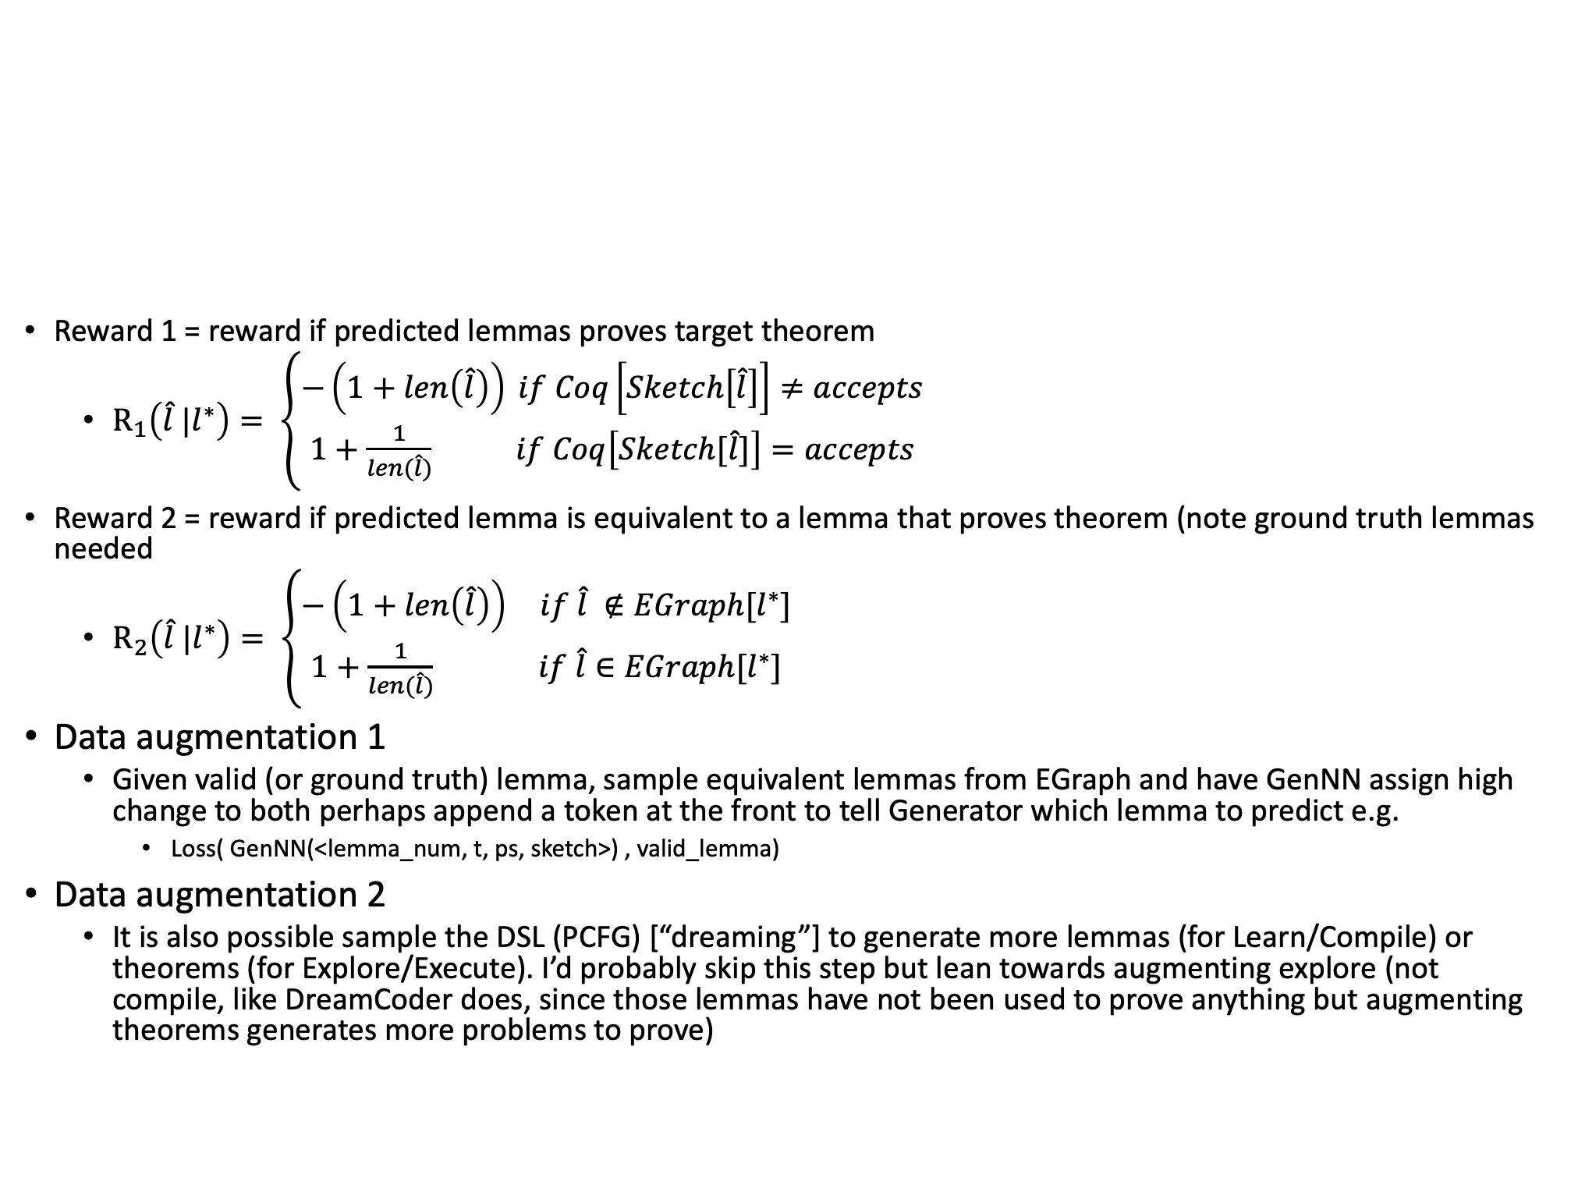
Possible Reward functions & data augmentation
Reward 1 = reward if predicted lemmas proves target theorem
$R_{1}\left(\hat{l} |l^{∗}\right)= \left\{\begin{aligned}−\left(1+len\left(\hat{l}\right)\right) if Coq\left[Sketch\left[\hat{l}\right]\right]≠accepts \\ 1+\frac{1}{len(\hat{l})} if Coq\left[Sketch[\hat{l}]\right]=accepts\end{aligned}\right.$
Reward 2 = reward if predicted lemma is equivalent to a lemma that proves theorem (note ground truth lemmas needed
$R_{2}\left(\hat{l} |l^{∗}\right)= \left\{\begin{aligned}−\left(1+len\left(\hat{l}\right)\right) if \hat{l} ∉EGraph[l^{∗}] \\ 1+\frac{1}{len(\hat{l})} if \hat{l}∈EGraph[l^{∗}]\end{aligned}\right.$
Data augmentation 1
Given valid (or ground truth) lemma, sample equivalent lemmas from EGraph and have GenNN assign high change to both perhaps append a token at the front to tell Generator which lemma to predict e.g.
Loss( GenNN(<lemma_num, t, ps, sketch>) , valid_lemma)
Data augmentation 2
It is also possible sample the DSL (PCFG) [“dreaming”] to generate more lemmas (for Learn/Compile) or theorems (for Explore/Execute). I’d probably skip this step but lean towards augmenting explore (not compile, like DreamCoder does, since those lemmas have not been used to prove anything but augmenting theorems generates more problems to prove)
Notes:
Would it be an issue to predict lemmas that yes are equivalent but might not advance the proof? But how do you know that the new format although fails for this theorem, that format might not fail for another future theorem. So perhaps learning both formats is still useful?
Note: that the -1 + num sub goals/ total goal, won’t be super useful because for a single lemma, if the right lemma is not guessed, then that will always be -1. Need to think through that again

Slide 23
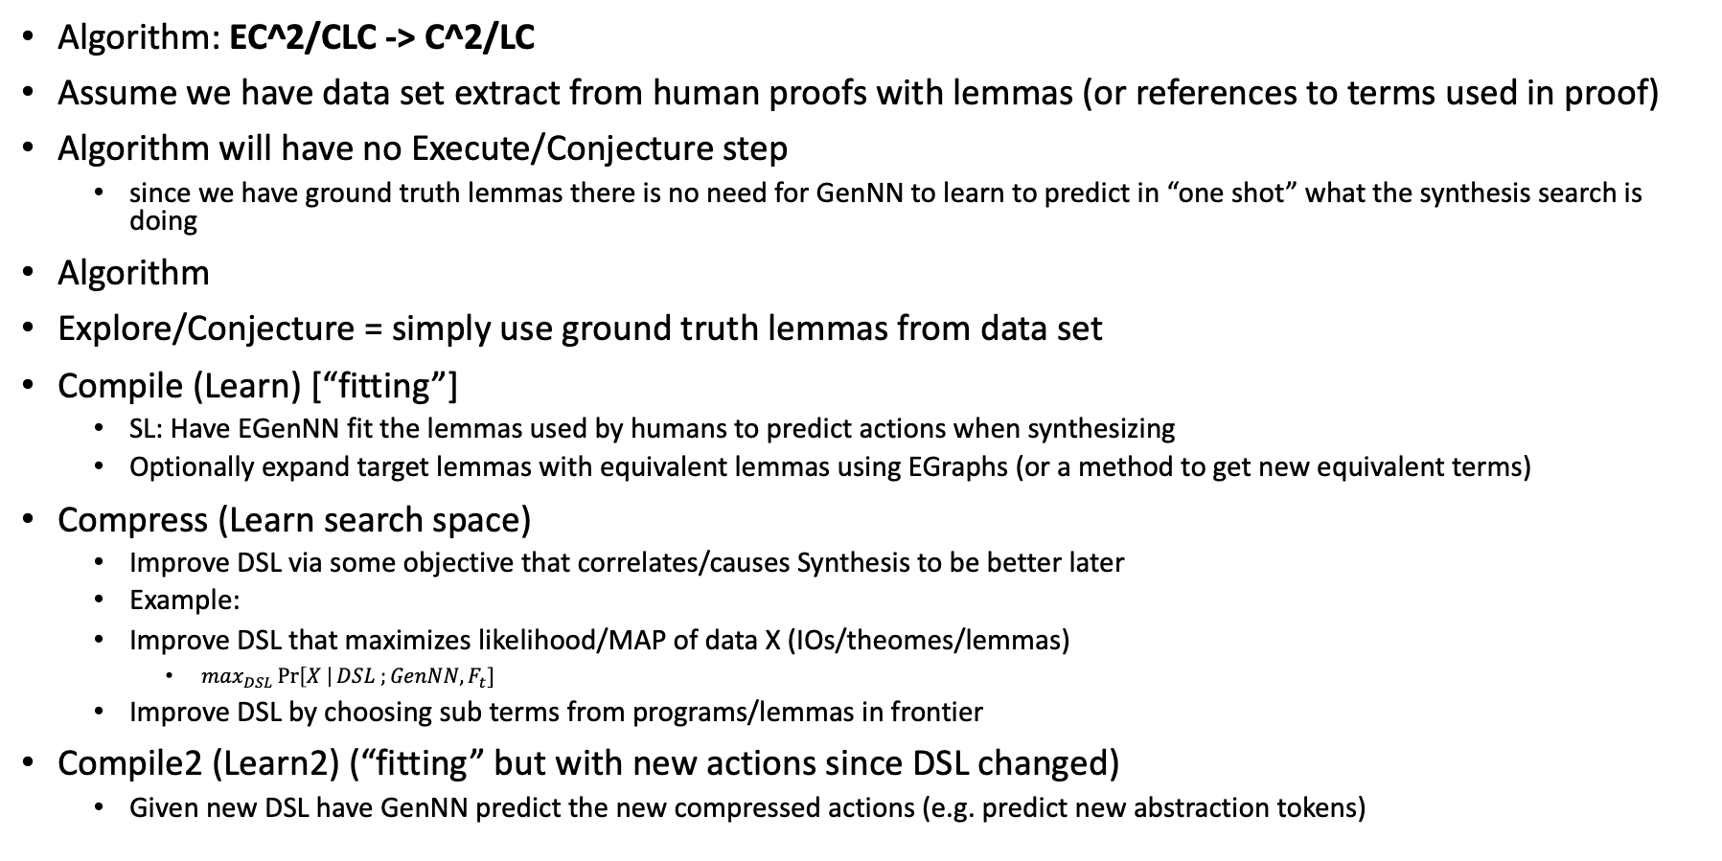
** Simplest Training Algorithm – Train from Human lemmas **
Algorithm: EC^2/CLC -> C^2/LC
Assume we have data set extract from human proofs with lemmas (or references to terms used in proof)
Algorithm will have no Execute/Conjecture step
since we have ground truth lemmas there is no need for GenNN to learn to predict in “one shot” what the synthesis search is doing
Algorithm
Explore/Conjecture = simply use ground truth lemmas from data set
Compile (Learn) [“fitting”]
SL: Have EGenNN fit the lemmas used by humans to predict actions when synthesizing
Optionally expand target lemmas with equivalent lemmas using EGraphs (or a method to get new equivalent terms)
Compress (Learn search space)
Improve DSL via some objective that correlates/causes Synthesis to be better later
Example:
Improve DSL that maximizes likelihood/MAP of data X (IOs/theomes/lemmas)
$\max_{DSL}\operatorname{Pr}\left[X \right|DSL ;GenNN, F_{t}]$
Improve DSL by choosing sub terms from programs/lemmas in frontier
Compile2 (Learn2) (“fitting” but with new actions since DSL changed)
Given new DSL have GenNN predict the new compressed actions (e.g. predict new abstraction tokens)
Notes:
Novel:
Applied to real language Coq
Innovate of Compress
Synthesis of lemmas

Slide 24
Innovations – using Simple Compile Compress/Learn Compress
Using C^2/LC
Explore/Conjecture -> is by passed by sampling ground truth theorems from data set e.g. CoqGym
Innovation
1. Application of Synthesis of Lemmas to a full fledge (complicated) language like Coq
Contrast DC/EC^2 to simple lambda calc – which is (to my understanding), only the back bone of LISP
2. New application to Synthesis of Lemmas – very important task for TP itself
FM community value it!
3. Algorithmically, improving compression algorithm
Expand beyond PCFG
Using deep learning
Combinatorial NN opt? or other techniques!
E-graphs to choose sub-expressions to add to DSL
Others I’ve not thought of yet?!
4. First time neutralizing original EC^2/adding significant Deep Learning components
Ideally we can make fundamental improvements to compress – beyond say, only neutralizing the probability distribution that PCFG/FG have

Slide 25
Dreamer

Slide 26
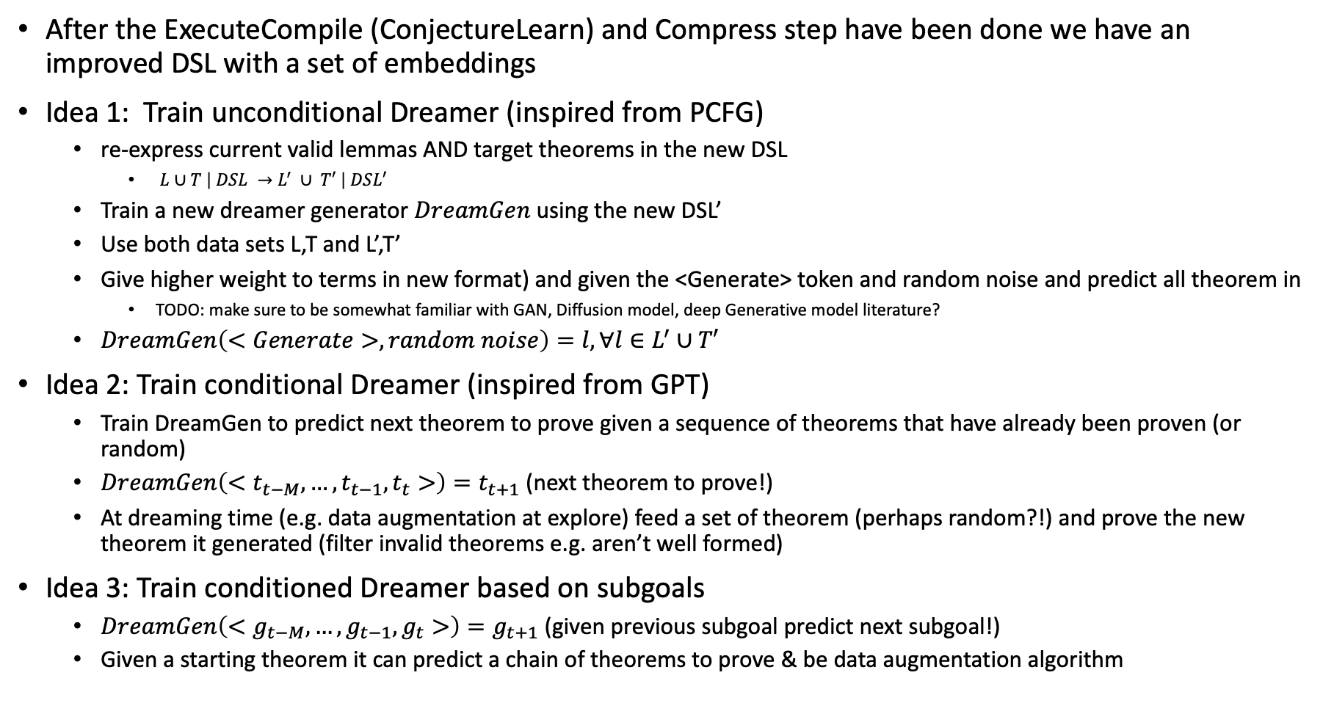
How to Dreams novel theorems to prove to augment data set?
After the ExecuteCompile (ConjectureLearn) and Compress step have been done we have an improved DSL with a set of embeddings
Idea 1: Train unconditional Dreamer (inspired from PCFG)
re-express current valid lemmas AND target theorems in the new DSL
$L∪T \left| DSL →L^{′} ∪ T′ \right| DSL′$
Train a new dreamer generator $DreamGen$ using the new DSL’
Use both data sets L,T and L’,T’
Give higher weight to terms in new format) and given the <Generate> token and random noise and predict all theorem in
TODO: make sure to be somewhat familiar with GAN, Diffusion model, deep Generative model literature?
$DreamGen\left(<Generate>, random noise\right)=l, ∀l∈L^{′}∪T′$
Idea 2: Train conditional Dreamer (inspired from GPT)
Train DreamGen to predict next theorem to prove given a sequence of theorems that have already been proven (or random)
$DreamGen\left(<t_{t−M},…, {t_{t−1},t}_{t}>\right)=t_{t+1}$ (next theorem to prove!)
At dreaming time (e.g. data augmentation at explore) feed a set of theorem (perhaps random?!) and prove the new theorem it generated (filter invalid theorems e.g. aren’t well formed)
Idea 3: Train conditioned Dreamer based on subgoals
$DreamGen\left(<g_{t−M},…, {g_{t−1},g}_{t}>\right)=g_{t+1}$ (given previous subgoal predict next subgoal!)
Given a starting theorem it can predict a chain of theorems to prove & be data augmentation algorithm
Notes:
Todo: read how PACT generates more data

Slide 27
Appendix

Slide 28
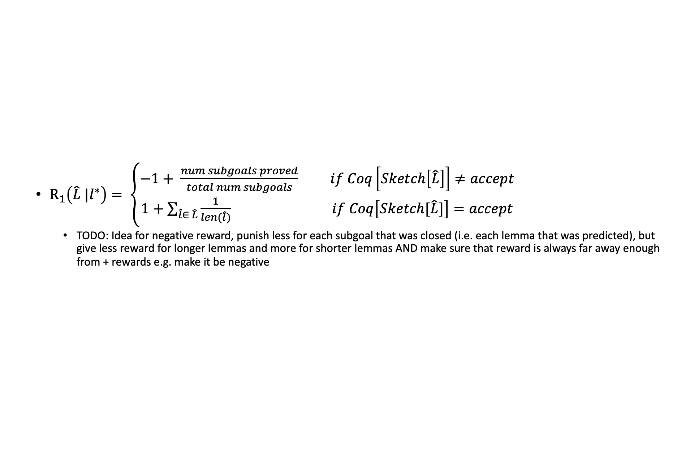
Reward function for prediction of multiple lemmas
$R_{1}\left(\hat{L} |l^{∗}\right)= \left\{\begin{aligned}−1+ \frac{num subgoals proved}{total num subgoals} if Coq\left[Sketch\left[\hat{L}\right]\right]≠accept \\ 1+\sum_{\hat{l}∈ \hat{L}}{\frac{1}{len(\hat{l})}} if Coq\left[Sketch[\hat{L}]\right]=accept\end{aligned}\right.$
TODO: Idea for negative reward, punish less for each subgoal that was closed (i.e. each lemma that was predicted), but give less reward for longer lemmas and more for shorter lemmas AND make sure that reward is always far away enough from + rewards e.g. make it be negative
Notes:
TODO: Idea for negative reward, punish less for each subgoal that was closed (i.e. each lemma that was predicted), but give less reward for longer lemmas and more for shorter lemmas AND make sure that reward is always far away enough from + rewards e.g. make it be negative

Slide 29
Compress Objective Derivation

Slide 30
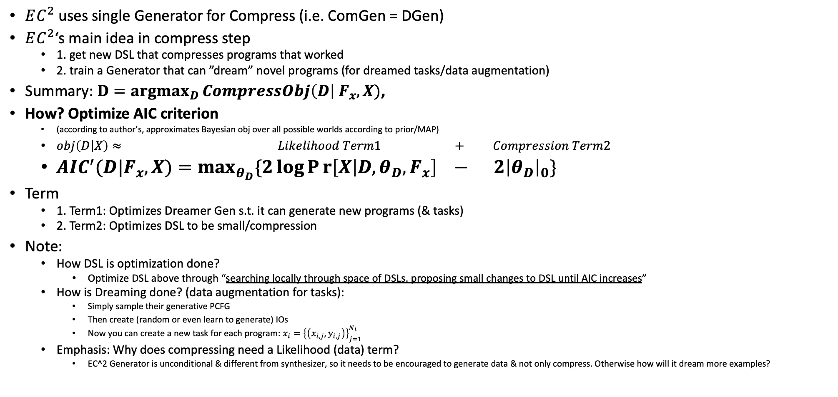
Outline & Learning objective for Compress step for $EC^{2}$
$EC^{2}$ uses single Generator for Compress (i.e. ComGen = DGen)
$EC^{2}$‘s main idea in compress step
1. get new DSL that compresses programs that worked
2. train a Generator that can ”dream” novel programs (for dreamed tasks/data augmentation)
Summary: $\underset{D}{D=argmax}{CompressObj\left(D\right| F_{x}, X)}$,
How? Optimize AIC criterion
(according to author’s, approximates Bayesian obj over all possible worlds according to prior/MAP)
$obj\left(D | X\right)≈ Likelihood Term1 + Compression Term2$
$AIC^{′}(D|F_{x}, X)=\max_{θ_{D}}{\{2\log{Pr\left[X | D, θ_{D}, F_{x}\right]}} − 2{\left|θ_{D}\right|}_{0}\}$
Term
1. Term1: Optimizes Dreamer Gen s.t. it can generate new programs (& tasks)
2. Term2: Optimizes DSL to be small/compression
Note:
How DSL is optimization done?
Optimize DSL above through “searching locally through space of DSLs, proposing small changes to DSL until AIC increases”
How is Dreaming done? (data augmentation for tasks):
Simply sample their generative PCFG
Then create (random or even learn to generate) IOs
Now you can create a new task for each program: $x_{i}={\left\{\left(x_{i,j}, y_{i,j}\right)\right\}}_{j=1}^{N_{i}}$
Emphasis: Why does compressing need a Likelihood (data) term?
EC^2 Generator is unconditional & different from synthesizer, so it needs to be encouraged to generate data & not only compress. Otherwise how will it dream more examples?
Notes:
NOTE: after that DSL’ is given get Gen by doing max_Gen Obj(X|DSL’)
Note: that they try to justify their aic via Bayesian reasoning but I’m skeptical that reasoning holds. I suppose they try to implicitly claim that their AIC criterion (i.e. compression) natively compresses which somehow is an approximation to choosing best DSL & DreamGen that minimizes all states of the world according to our updated prior/MAP? i.e.
obj = AIC(D|X) = max_theta 2|theta|_0 – 2 log Pr[X|D, theta] <-> obj = int_theta Pr[X|theta, D] dtheta
EC^2 does not use a transformer Generator or AR to generate
Dreamer augments data set, improves compile step. No need to synthesize these in execute step since you have “ground truth pgms” from generator. Simply create IOs x to train NR directly in Compile step
Replace intergral of theta with it’s “largest element” with the max_theta

Slide 31
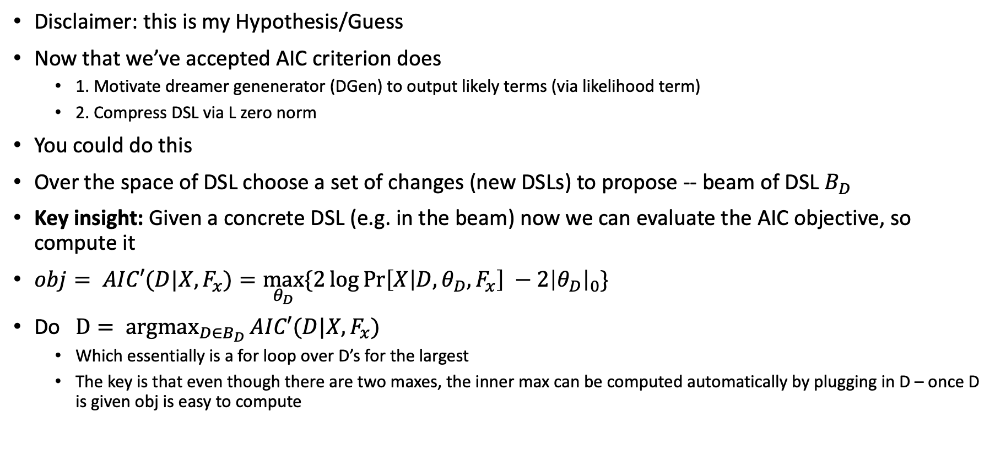
How might the DSL optimization be done?
Disclaimer: this is my Hypothesis/Guess
Now that we’ve accepted AIC criterion does
1. Motivate dreamer genenerator (DGen) to output likely terms (via likelihood term)
2. Compress DSL via L zero norm
You could do this
Over the space of DSL choose a set of changes (new DSLs) to propose -- beam of DSL $B_{D}$
Key insight: Given a concrete DSL (e.g. in the beam) now we can evaluate the AIC objective, so compute it
$obj= AIC′(D|X, F_{x})=\max_{θ_{D}}{\{2\log{\operatorname{Pr}\left[X | D, θ_{D}, F_{x}\right]}} −2{\left|θ_{D}\right|}_{0}\}$
Do $\underset{D∈B_{D}}{D= argmax}{AIC′(D|X, F_{x})}$
Which essentially is a for loop over D’s for the largest
The key is that even though there are two maxes, the inner max can be computed automatically by plugging in D – once D is given obj is easy to compute

Slide 32
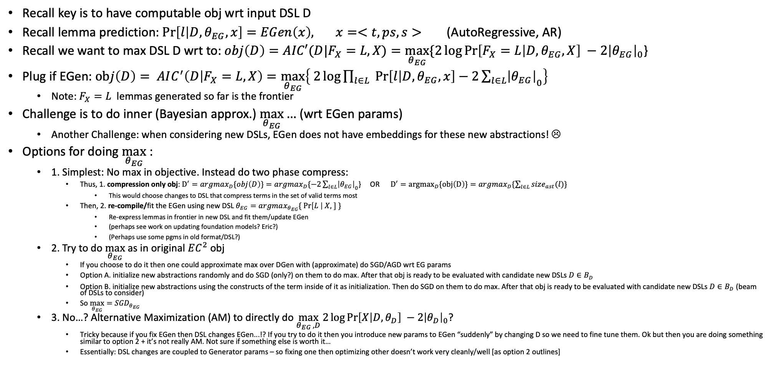
Optimizing for a DSL and an AutoRegressive (AR) Execute Generator (1)
Recall key is to have computable obj wrt input DSL D
Recall lemma prediction: $\operatorname{Pr}\left[l | D, θ_{EG},x\right]=EGen\left(x\right), x=<t, ps, s>$ (AutoRegressive, AR)
Recall we want to max DSL D wrt to:$obj\left(D\right)=AIC′(D|F_{X}=L, X)=\max_{θ_{EG}}{\{2\log{\operatorname{Pr}\left[F_{X}=L | D, θ_{EG}, X\right]}} −2{\left|θ_{EG}\right|}_{0}$}
Plug if EGen: $obj\left(D\right)= AIC^{′}\left(D | F_{X}=L, X\right)=\max_{θ_{EG}}\left\{ 2\log{\prod_{l∈L}{\operatorname{Pr}\left[l | D,θ_{EG},x\right]}}−2{\sum_{l∈L}{\left|θ_{EG}\right|}}_{0}\right\}$
Note: $F_{X}=L$ lemmas generated so far is the frontier
Challenge is to do inner (Bayesian approx.) $\max_{θ_{EG}}{…}$ (wrt EGen params)
Another Challenge: when considering new DSLs, EGen does not have embeddings for these new abstractions! ☹
Options for doing $\max_{θ_{EG}}$:
1. Simplest: No max in objective. Instead do two phase compress:
Thus, 1. compression only obj: $D^{′}=argmax_{D}\{obj\left(D\right)\}=argmax_{D}\{−2{\sum_{l∈L}{\left|θ_{EG}\right|}}_{0}$} OR $D^{′}={argmax}_{D}\{obj\left(D\right)\}=argmax_{D}\{\sum_{l∈L}{size_{ast}(l)\}}$
This would choose changes to DSL that compress terms in the set of valid terms most
Then, 2. re-compile/fit the EGen using new DSL $θ_{EG}=argmax_{θ_{EG}}\{ \operatorname{Pr}\left[L \right| X, ] \}$
Re-express lemmas in frontier in new DSL and fit them/update EGen
(perhaps see work on updating foundation models? Eric?)
(Perhaps use some pgms in old format/DSL?)
2. Try to do $\max_{θ_{EG}}$ as in original $EC^{2}$ obj
If you choose to do it then one could approximate max over DGen with (approximate) do SGD/AGD wrt EG params
Option A. initialize new abstractions randomly and do SGD (only?) on them to do max. After that obj is ready to be evaluated with candidate new DSLs $D∈B_{D}$
Option B. initialize new abstractions using the constructs of the term inside of it as initialization. Then do SGD on them to do max. After that obj is ready to be evaluated with candidate new DSLs $D∈B_{D}$ (beam of DSLs to consider)
So $\max_{θ_{EG}}={SGD}_{θ_{EG}}$
3. No…? Alternative Maximization (AM) to directly do $\max_{θ_{EG },D}{2\log{\operatorname{Pr}\left[X | D, θ_{D}\right]}} −2{\left|θ_{D}\right|}_{0}$?
Tricky because if you fix EGen then DSL changes EGen...!? If you try to do it then you introduce new params to EGen “suddenly” by changing D so we need to fine tune them. Ok but then you are doing something similar to option 2 + it’s not really AM. Not sure if something else is worth it…
Essentially: DSL changes are coupled to Generator params – so fixing one then optimizing other doesn’t work very cleanly/well [as option 2 outlines]
Notes:
Issue with AM. We can’t do maximization of EG first because we just did a compile. Ok fine, let’s do optimization over D.
Ok that is hard, currently my understanding is doing small changes to DSL then evaluating objective (note this could a place were NN could guide the search!). (Perhaps would benefit of knowing more options of how search over DSL is done).
If we get a beam of changes, then what? Then we could optimize EG. But how? We can’t maximize until we get the DSL changes. So fix them and do it, ok then it start looking very similar to the above thing.
In other AM/EM type of work, once we fix one parameter (or coordinate) then it DOES make sense to optimize over the other one. Here, when you have EG fixed and then try to optimize over D, you can’t just optimize over D because, new D’ can be evaluated I suppose on obj but it introduces new params that EG is not aware of, so it’s awkward. But trying to fine tune suddenly means that you aren’t alternating. It’s more like what the above algorithm I suggested is doing.
How to evaluate AIC when optimizing for a DSL with AutoRegressive (AR) Generator: given changed DSLs in a beam, now they are “fixed” so they can be plugged into the max since the max needs that to be fixed. Plug them in, do the max for the plugged in value and choose the DSL that made the biggest improvement.

Slide 33
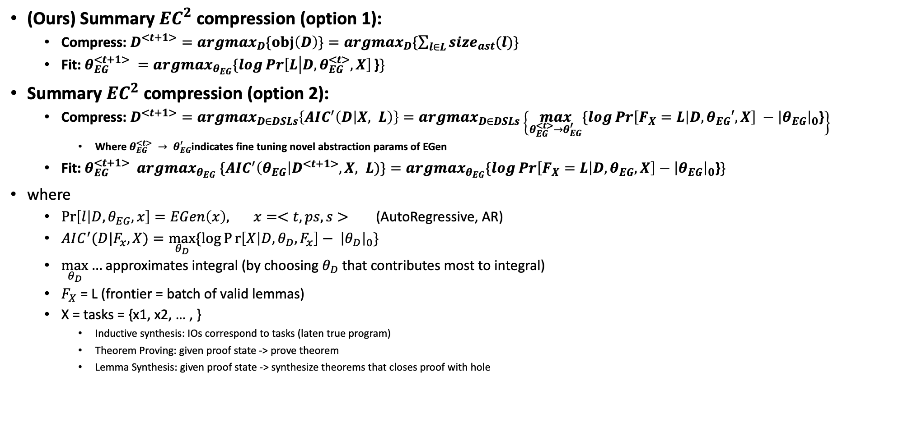
Optimizing for a DSL and an AutoRegressive (AR) Execute Generator (2)
(Ours) Summary $EC^{2}$ compression (option 1):
Compress: $D^{<t+1>}={argmax}_{D}\{obj\left(D\right)\}=argmax_{D}\{\sum_{l∈L}{size_{ast}(l)\}}$
Fit: $θ_{EG}^{<t+1>} =argmax_{θ_{EG}}\{\log{\operatorname{Pr}\left[L | D, θ_{EG}^{<t>}, X\right]}\text{\}}\}$
Summary $EC^{2}$ compression (option 2):
Compress: $D^{<t+1>}=argmax_{D∈DSLs}\left\{AIC^{′}\left(D | X, L\right)\right\}=argmax_{D∈DSLs}\left\{\max_{θ_{EG}^{<t>}→θ_{EG}^{′}}{\{\log{\operatorname{Pr}\left[F_{X}=L | D, θ_{EG}′, X\right]}} −{\left|θ_{EG}\right|}_{0}\text{\}}\right\}$
Where${ θ_{EG}^{<t>} → θ}_{EG}^{′}$indicates fine tuning novel abstraction params of EGen
Fit: $θ_{EG}^{<t+1>} argmax_{θ_{EG}} \{AIC^{′}\left(θ_{EG}\right|D^{<t+1>}, X, L)\}=argmax_{θ_{EG}}\{\log{\operatorname{Pr}\left[F_{X}=L | D, θ_{EG}, X\right]}−{\left|θ_{EG}\right|}_{0}\text{\}}\}$
where
$\operatorname{Pr}\left[l | D, θ_{EG},x\right]=EGen\left(x\right), x=<t, ps, s>$ (AutoRegressive, AR)
$AIC^{′}(D|F_{x}, X)=\max_{θ_{D}}{\{\log{Pr\left[X | D, θ_{D}, F_{x}\right]}}− {\left|θ_{D}\right|}_{0}\}$
$\max_{θ_{D}}{…}$approximates integral (by choosing $θ_{D}$ that contributes most to integral)
$F_{X}$ = L (frontier = batch of valid lemmas)
X = tasks = {x1, x2, … , }
Inductive synthesis: IOs correspond to tasks (laten true program)
Theorem Proving: given proof state -> prove theorem
Lemma Synthesis: given proof state -> synthesize theorems that closes proof with hole
Notes:
Issue with AM. We can’t do maximization of EG first because we just did a compile. Ok fine, let’s do optimization over D.
Ok that is hard, currently my understanding is doing small changes to DSL then evaluating objective (note this could a place were NN could guide the search!). (Perhaps would benefit of knowing more options of how search over DSL is done).
If we get a beam of changes, then what? Then we could optimize EG. But how? We can’t maximize until we get the DSL changes. So fix them and do it, ok then it start looking very similar to the above thing.
In other AM/EM type of work, once we fix one parameter (or coordinate) then it DOES make sense to optimize over the other one. Here, when you have EG fixed and then try to optimize over D, you can’t just optimize over D because, new D’ can be evaluated I suppose on obj but it introduces new params that EG is not aware of, so it’s awkward. But trying to fine tune suddenly means that you aren’t alternating. It’s more like what the above algorithm I suggested is doing.
How to evaluate AIC when optimizing for a DSL with AutoRegressive (AR) Generator: given changed DSLs in a beam, now they are “fixed” so they can be plugged into the max since the max needs that to be fixed. Plug them in, do the max for the plugged in value and choose the DSL that made the biggest improvement.

Slide 34
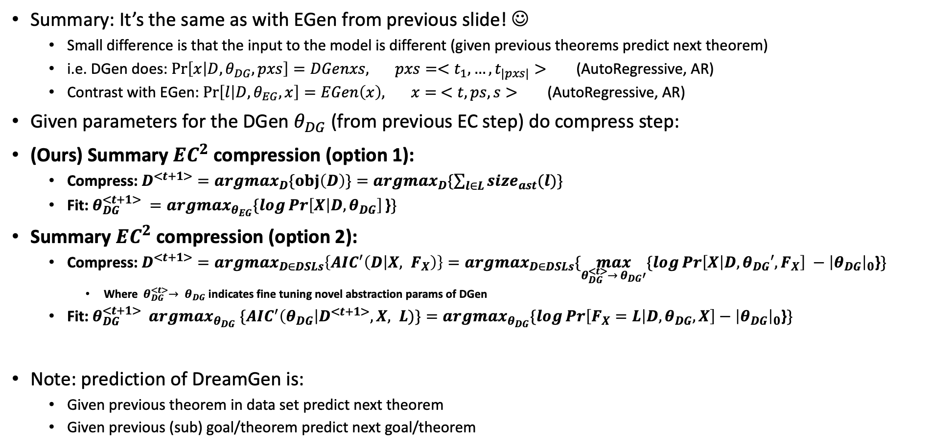
What about if we had a Dreamer Generator?
Summary: It’s the same as with EGen from previous slide! ☺
Small difference is that the input to the model is different (given previous theorems predict next theorem)
i.e. DGen does: $\operatorname{Pr}\left[x | D, θ_{DG},pxs\right]=DGenxs, pxs=<t_{1}, …, t_{|pxs|}>$ (AutoRegressive, AR)
Contrast with EGen: $\operatorname{Pr}\left[l | D, θ_{EG},x\right]=EGen\left(x\right), x= <t, ps, s>$ (AutoRegressive, AR)
Given parameters for the DGen $θ_{DG}$ (from previous EC step) do compress step:
(Ours) Summary $EC^{2}$ compression (option 1):
Compress: $D^{<t+1>}={argmax}_{D}\{obj\left(D\right)\}=argmax_{D}\{\sum_{l∈L}{size_{ast}(l)\}}$
Fit: $θ_{DG}^{<t+1>} =argmax_{θ_{EG}}\{\log{\operatorname{Pr}\left[X | D, θ_{DG}\right]}\text{\}}\}$
Summary $EC^{2}$ compression (option 2):
Compress: $D^{<t+1>}=argmax_{D∈DSLs}\left\{AIC^{′}\left(D | X, F_{X}\right)\right\}=argmax_{D∈DSLs}\{\max_{{θ_{DG}^{<t>}→ θ}_{DG}′}{\{\log{\operatorname{Pr}\left[X | D,θ_{DG}′, F_{X}\right]}} −{\left|θ_{DG}\right|}_{0}\text{\}}\}$
Where${{ θ}_{DG}^{<t>}→ θ}_{DG}$ indicates fine tuning novel abstraction params of DGen
Fit: $θ_{DG}^{<t+1>} argmax_{θ_{DG}} \{AIC^{′}\left(θ_{DG}\right|D^{<t+1>}, X, L)\}=argmax_{θ_{DG}}\{\log{\operatorname{Pr}\left[F_{X}=L | D, θ_{DG}, X\right]}−{\left|θ_{DG}\right|}_{0}\text{\}}\}$
Note: prediction of DreamGen is:
Given previous theorem in data set predict next theorem
Given previous (sub) goal/theorem predict next goal/theorem
Notes:
Note: s=sketch, ideally both tactic sketch and proof term sketch or tactic sketch and proof term up to that point given to model

Slide 35
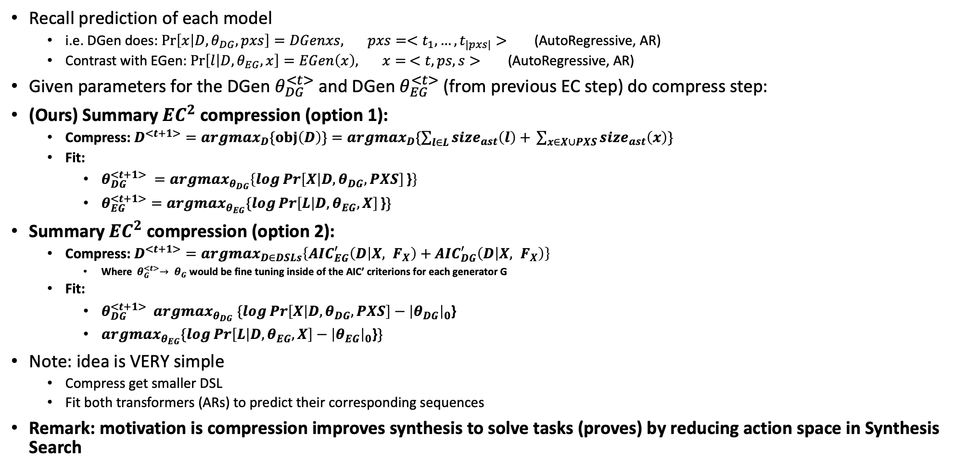
What about if we had BOTH Execute and Dreamer Generator?
Recall prediction of each model
i.e. DGen does: $\operatorname{Pr}\left[x | D, θ_{DG},pxs\right]=DGenxs, pxs=<t_{1}, …, t_{|pxs|}>$ (AutoRegressive, AR)
Contrast with EGen: $\operatorname{Pr}\left[l | D, θ_{EG},x\right]=EGen\left(x\right), x= <t, ps, s>$ (AutoRegressive, AR)
Given parameters for the DGen $θ_{DG}^{<t>}$ and DGen $θ_{EG}^{<t>}$ (from previous EC step) do compress step:
(Ours) Summary $EC^{2}$ compression (option 1):
Compress: $D^{<t+1>}={argmax}_{D}\{obj\left(D\right)\}=argmax_{D}\{\sum_{l∈L}{size_{ast}\left(l\right)+ }\sum_{x∈X∪PXS}{size_{ast}\left(x\right)}\}$
Fit:
$θ_{DG}^{<t+1>} =argmax_{θ_{DG}}\left\{\log{\operatorname{Pr}\left[X | D, θ_{DG}, PXS\right]}\text{\}}\right\}$
$θ_{EG}^{<t+1>}=argmax_{θ_{EG}}\{\log{\operatorname{Pr}\left[L | D, θ_{EG}, X\right]}\text{\}}\}$
Summary $EC^{2}$ compression (option 2):
Compress: $D^{<t+1>}=argmax_{D∈DSLs}\left\{AIC_{EG}^{′}\left(D | X, F_{X}\right)+AIC_{DG}^{′}\left(D | X, F_{X}\right)\right\}$
Where${{ θ}_{G}^{<t>}→ θ}_{G}$ would be fine tuning inside of the AIC’ criterions for each generator G
Fit:
$θ_{DG}^{<t+1>} argmax_{θ_{DG}} \{\log{\operatorname{Pr}\left[X | D, θ_{DG}, PXS\right]}−{\left|θ_{DG}\right|}_{0}\text{\}}$
$argmax_{θ_{EG}}\{\log{\operatorname{Pr}\left[L | D, θ_{EG}, X\right]}−{\left|θ_{EG}\right|}_{0}\text{\}}\}$
Note: idea is VERY simple
Compress get smaller DSL
Fit both transformers (ARs) to predict their corresponding sequences
Remark: motivation is compression improves synthesis to solve tasks (proves) by reducing action space in Synthesis Search
Notes:
Note: s=sketch, ideally both tactic sketch and proof term sketch or tactic sketch and proof term up to that point given to model

Slide 36
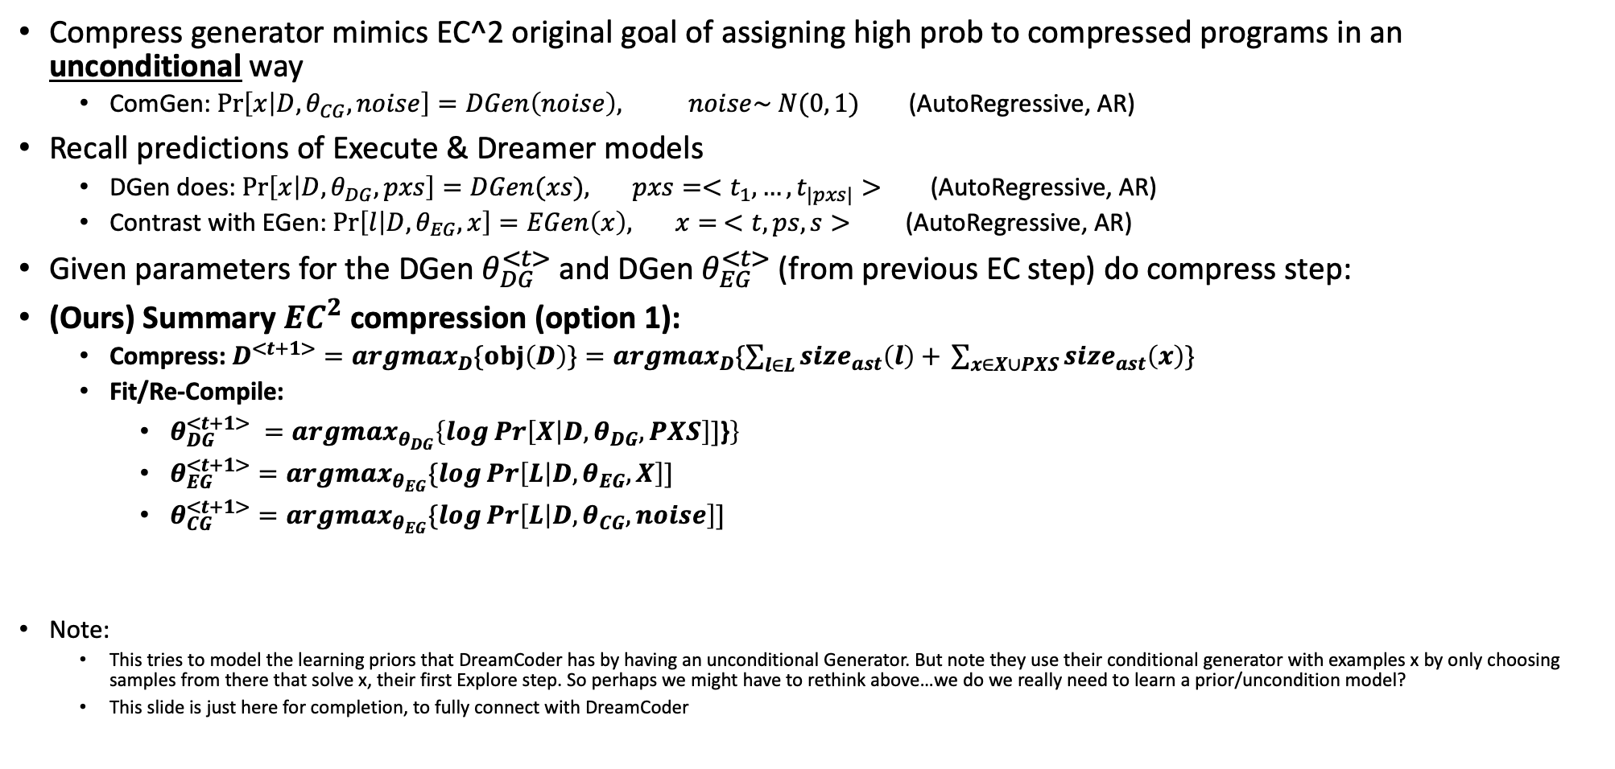
What about if we had all three Execute, Dreamer and Compress Generator?
Compress generator mimics EC^2 original goal of assigning high prob to compressed programs in an unconditional way
ComGen: $\operatorname{Pr}\left[x | D, θ_{CG}, noise\right]=DGen\left(noise\right), noise\sim N(0, 1)$ (AutoRegressive, AR)
Recall predictions of Execute & Dreamer models
DGen does: $\operatorname{Pr}\left[x | D, θ_{DG},pxs\right]=DGen(xs), pxs=<t_{1}, …, t_{|pxs|}>$ (AutoRegressive, AR)
Contrast with EGen: $\operatorname{Pr}\left[l | D, θ_{EG},x\right]=EGen\left(x\right), x= <t, ps, s>$ (AutoRegressive, AR)
Given parameters for the DGen $θ_{DG}^{<t>}$ and DGen $θ_{EG}^{<t>}$ (from previous EC step) do compress step:
(Ours) Summary $EC^{2}$ compression (option 1):
Compress: $D^{<t+1>}={argmax}_{D}\{obj\left(D\right)\}=argmax_{D}\{\sum_{l∈L}{size_{ast}\left(l\right)+ }\sum_{x∈X∪PXS}{size_{ast}\left(x\right)}\}$
Fit/Re-Compile:
$θ_{DG}^{<t+1>} =argmax_{θ_{DG}}\left\{\log{\operatorname{Pr}\left[X | D, θ_{DG}, PXS\right]}]\text{\}}\right\}$
$θ_{EG}^{<t+1>}=argmax_{θ_{EG}}\{\log{\operatorname{Pr}\left[L | D, θ_{EG}, X\right]}]$
$θ_{CG}^{<t+1>}=argmax_{θ_{EG}}\{\log{\operatorname{Pr}\left[L | D, θ_{CG}, noise\right]}]$
Note:
This tries to model the learning priors that DreamCoder has by having an unconditional Generator. But note they use their conditional generator with examples x by only choosing samples from there that solve x, their first Explore step. So perhaps we might have to rethink above…we do we really need to learn a prior/uncondition model?
This slide is just here for completion, to fully connect with DreamCoder

Slide 37
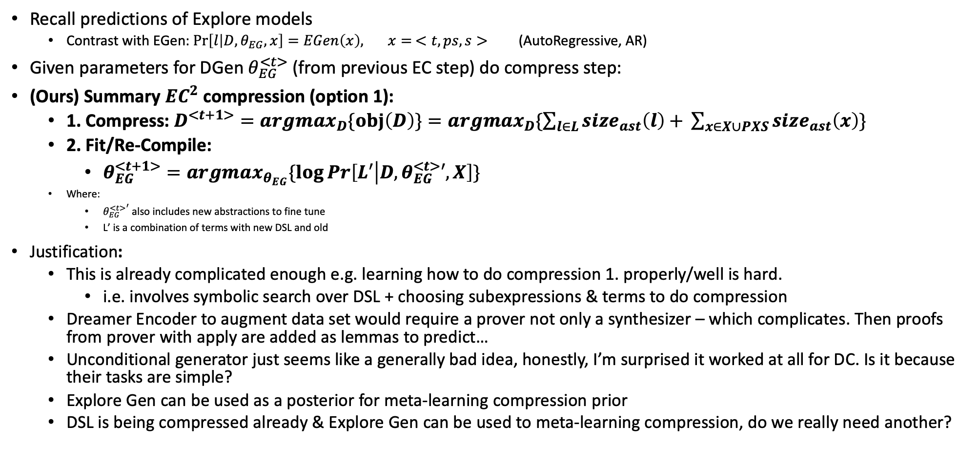
Final Decision for compression step
Recall predictions of Explore models
Contrast with EGen: $\operatorname{Pr}\left[l | D, θ_{EG},x\right]=EGen\left(x\right), x= <t, ps, s>$ (AutoRegressive, AR)
Given parameters for DGen $θ_{EG}^{<t>}$ (from previous EC step) do compress step:
(Ours) Summary $EC^{2}$ compression (option 1):
1. Compress: $D^{<t+1>}={argmax}_{D}\{obj\left(D\right)\}=argmax_{D}\{\sum_{l∈L}{size_{ast}\left(l\right)+ }\sum_{x∈X∪PXS}{size_{ast}\left(x\right)}\}$
2. Fit/Re-Compile:
$θ_{EG}^{<t+1>}=argmax_{θ_{EG}}\{\log{\operatorname{Pr}\left[L′ | D, θ_{EG}^{<t>}′, X\right]}\}$
Where:
${θ_{EG}^{<t>}}^{′}$ also includes new abstractions to fine tune
L’ is a combination of terms with new DSL and old
Justification:
This is already complicated enough e.g. learning how to do compression 1. properly/well is hard.
i.e. involves symbolic search over DSL + choosing subexpressions & terms to do compression
Dreamer Encoder to augment data set would require a prover not only a synthesizer – which complicates. Then proofs from prover with apply are added as lemmas to predict…
Unconditional generator just seems like a generally bad idea, honestly, I’m surprised it worked at all for DC. Is it because their tasks are simple?
Explore Gen can be used as a posterior for meta-learning compression prior
DSL is being compressed already & Explore Gen can be used to meta-learning compression, do we really need another?

Slide 38
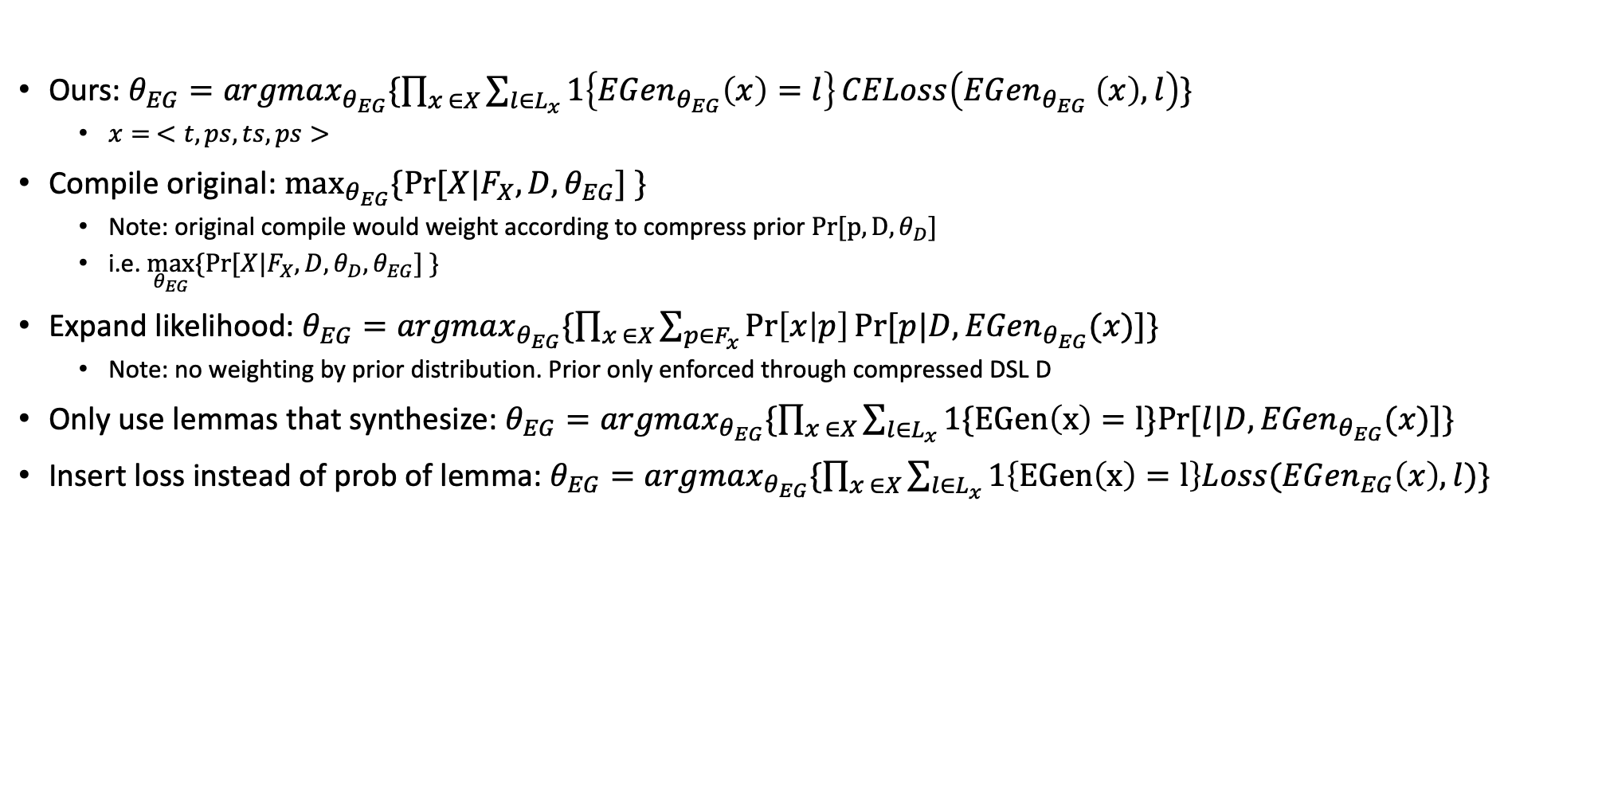
Connection of our Learn/Compile step to EC^2
Ours: $θ_{EG}=argmax_{θ_{EG}}\{\prod_{x ∈X}{\sum_{l∈L_{x}}{1\left\{EGen_{θ_{EG}}\left(x\right)=l\right\}{CELoss\left(EGen_{θ_{EG}} \left(x\right), l\right)}}}\}$
$x= <t, ps, ts, ps>$
Compile original: $\max_{θ_{EG}}{\{Pr⁡[X|F_{X},D, θ_{EG}] \}}$
Note: original compile would weight according to compress prior $Pr[p, D, θ_{D}]$
i.e. $\max_{θ_{EG}}{\{Pr⁡[X|F_{X},D, θ_{D},θ_{EG}] \}}$
Expand likelihood: $θ_{EG}=argmax_{θ_{EG}}\{\prod_{x ∈X}{\sum_{p∈F_{x}}{\operatorname{Pr}\left[x | p\right]Pr⁡[p|D,EGen_{θ_{EG}}(x)]}}\}$
Note: no weighting by prior distribution. Prior only enforced through compressed DSL D
Only use lemmas that synthesize: $θ_{EG}=argmax_{θ_{EG}}\{\prod_{x ∈X}{\sum_{l∈L_{x}}{1\{EGen\left(x\right)=l\}Pr⁡[l|D,EGen_{θ_{EG}}(x)]}}\}$
Insert loss instead of prob of lemma: $θ_{EG}=argmax_{θ_{EG}}\{\prod_{x ∈X}{\sum_{l∈L_{x}}{1\left\{EGen\left(x\right)=l\right\}Loss(EGen_{EG}\left(x\right), l)}}\}$

Slide 39
Questions

Slide 40
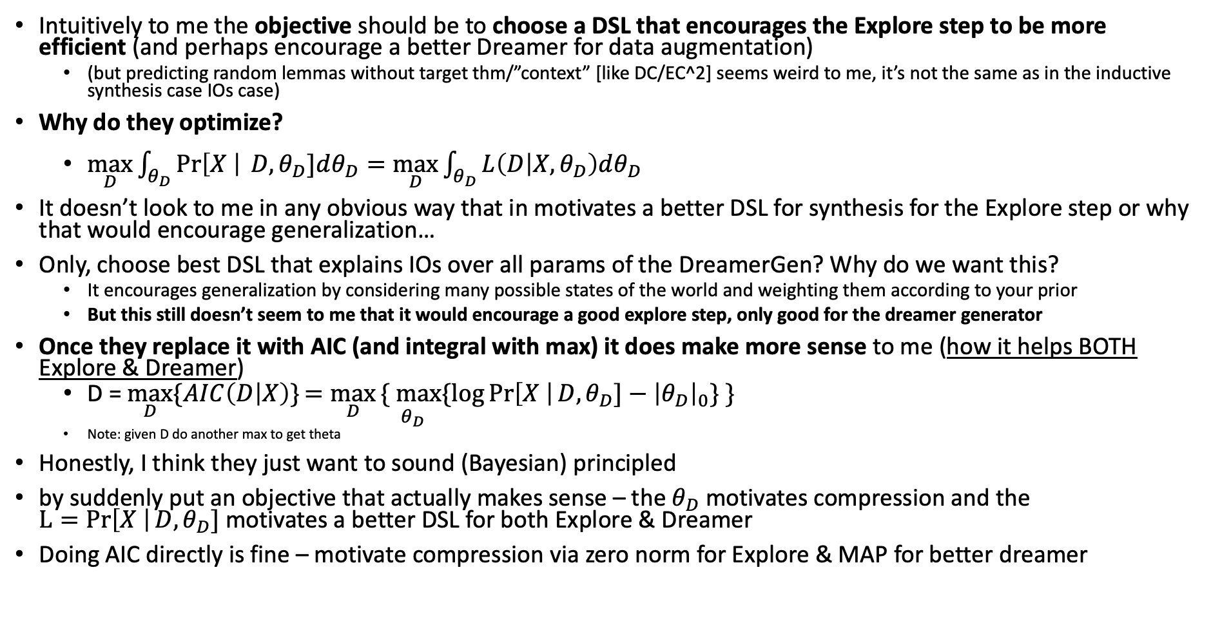
Is it really a good idea to optimize for the Bayesian objective when choosing a DSL?
Intuitively to me the objective should be to choose a DSL that encourages the Explore step to be more efficient (and perhaps encourage a better Dreamer for data augmentation)
(but predicting random lemmas without target thm/”context” [like DC/EC^2] seems weird to me, it’s not the same as in the inductive synthesis case IOs case)
Why do they optimize?
$\max_{D}{\int_{θ_{D}}{\operatorname{Pr}\left[X \right| D, θ_{D}]dθ_{D}}=\max_{D}{\int_{θ_{D}}{L\left(D | X, θ_{D}\right)dθ_{D}}}}$
It doesn’t look to me in any obvious way that in motivates a better DSL for synthesis for the Explore step or why that would encourage generalization…
Only, choose best DSL that explains IOs over all params of the DreamerGen? Why do we want this?
It encourages generalization by considering many possible states of the world and weighting them according to your prior
But this still doesn’t seem to me that it would encourage a good explore step, only good for the dreamer generator
Once they replace it with AIC (and integral with max) it does make more sense to me (how it helps BOTH Explore & Dreamer)
D = $\max_{D}{\{AIC\left(D | X\right)\}}=\max_{D}{\underset{ θ_{D}}{\{ max}\{log{\operatorname{Pr}\left[X \right|D,θ_{D}]}−{\left|θ_{D}\right|}_{0}\} \}}$
Note: given D do another max to get theta
Honestly, I think they just want to sound (Bayesian) principled
by suddenly put an objective that actually makes sense – the $θ_{D}$motivates compression and the $L=Pr\left[X \right|D,θ_{D}]$motivates a better DSL for both Explore & Dreamer
Doing AIC directly is fine – motivate compression via zero norm for Explore & MAP for better dreamer
Notes:
Perhaps what we want is an objective that does both:
1. Encourage the DreamerGen to dream/generate better terms. But which terms should it try to generate? More target theorems? What is the point of generating random lemmas without context? For DC/EC^2 generating random pgms is good because they can use that as additional training data. The IOs are generated by selecting (random) inputs and getting the outputs from the dreamed programs. Perhaps train dreamer to generate good examples that predict good synthesis on the validation data?
2. Encourages the ExploreGen to generate better terms.
Q: What would be an objective that encourages both?
Is the Bayesian criterion good because you choose a DSL that explains the IOs (X) over many possible generative models? So you are intrinsically generalizing by considering many possible states of the world giving more weights to the more likely ones?
Q: is it possible in some way to have the DreamerGen and ExploreGen share weights?

Slide 41
Q: Is it possible to have ExploreGen and Dreamgen share weights somehow?
TODO

